Slide 1





How does environmental stochasticity affect animal movement?
Stefano Mezzini
Ph.D. Biology candidate

Slide 2
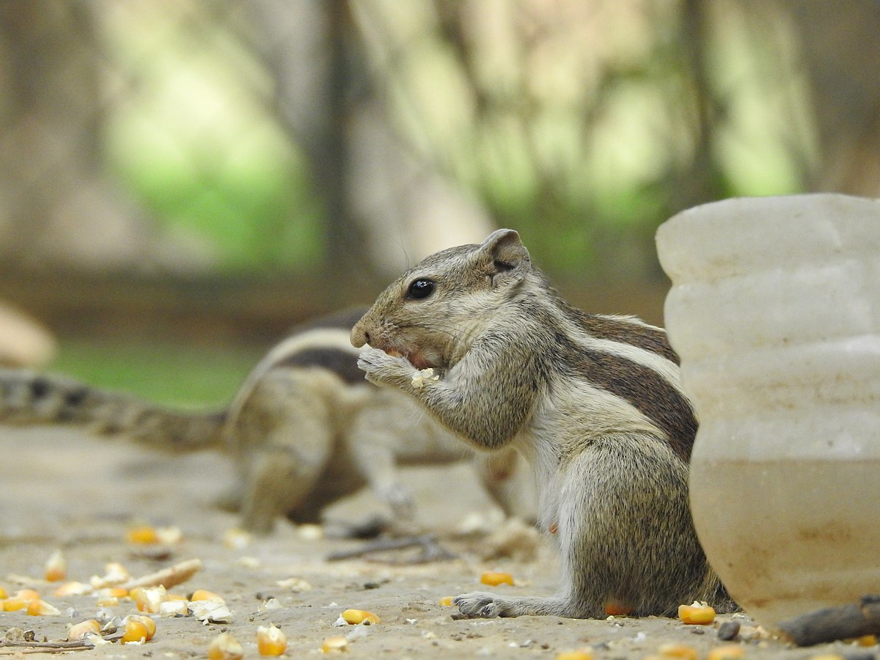
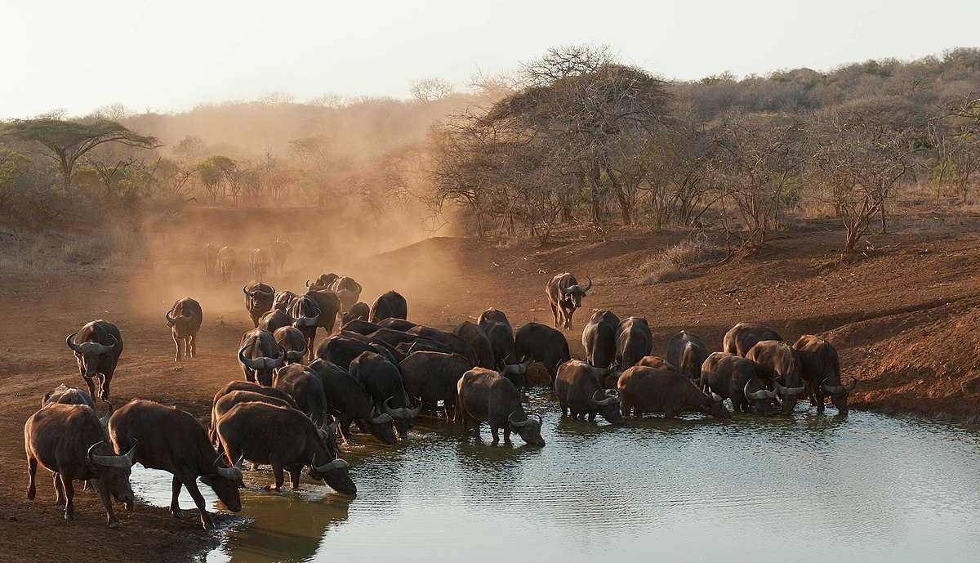
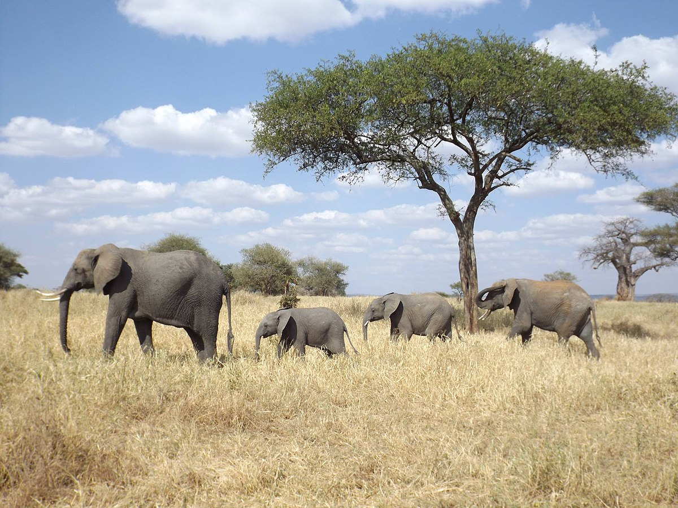
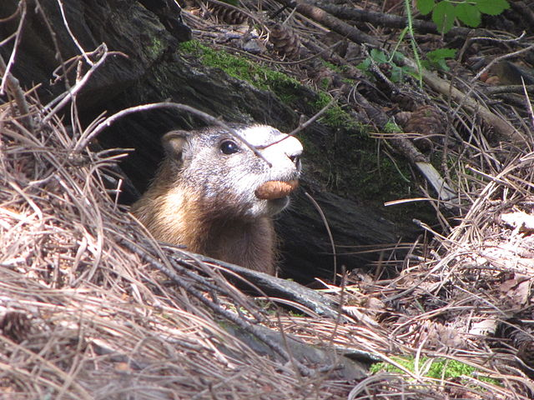
Why do animals move?
African buffalos drinking at a pond
photo by safaritravelplus, CC0, via Wikimedia Commons
Food/nutrients
Water
New den/nest
Mate/group
And many other reasons…
Use home range size as a proxy for all needs
Foraging chipmunk, photo by Prashant Saini,
CC BY-SA 4.0, via Wikimedia Commons
Mother elephant with offspring,
photo by Floodmfx, CC0, via Wikimedia Commons
Black hills marmot, photo by Njschock,
CC BY-SA 3.0, via Wikimedia Commons

Slide 3
Resource abundance and HR

Slide 4
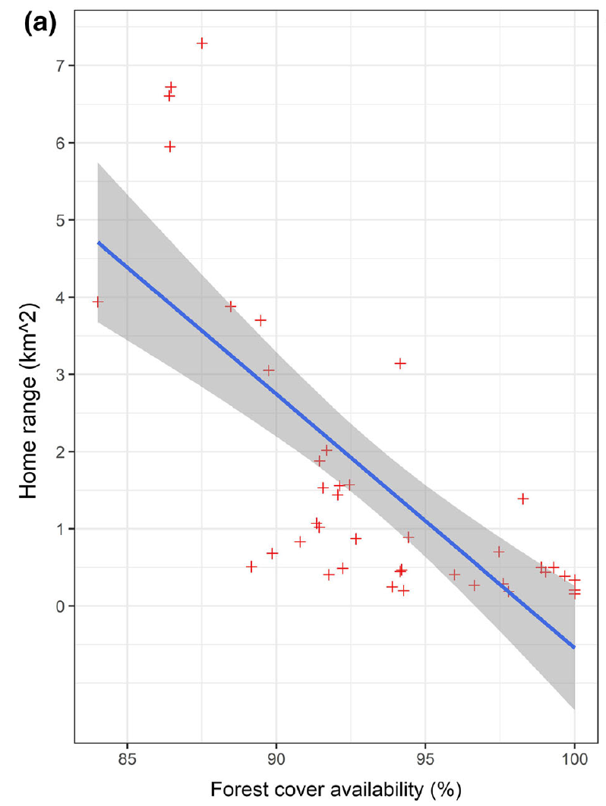
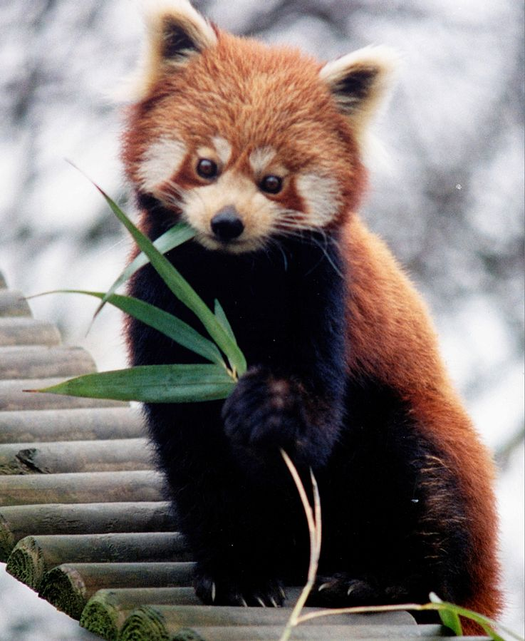
Resource abundance and HR: examples in literature
HR size (km²)
Red panda,
photo by Brunswyk, CC BY-SA 3.0,
via Wikimedia Commons
(Bista et al. 2022)
Forest cover (%)

Slide 5
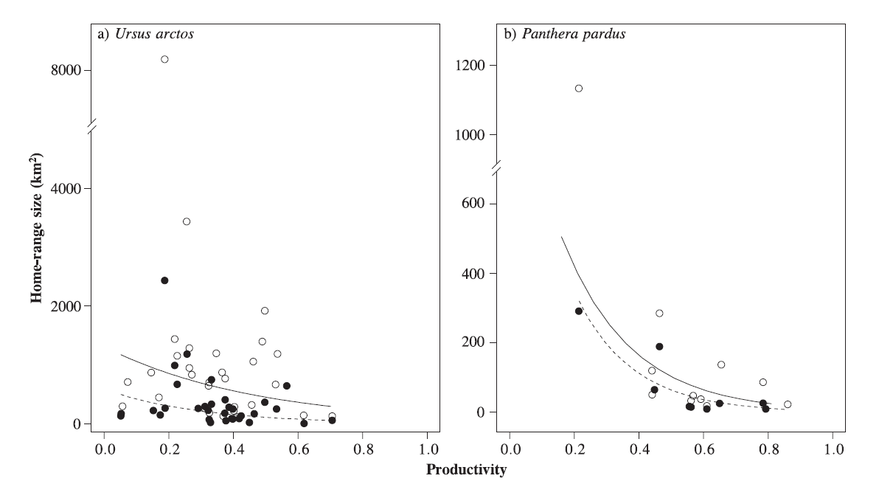
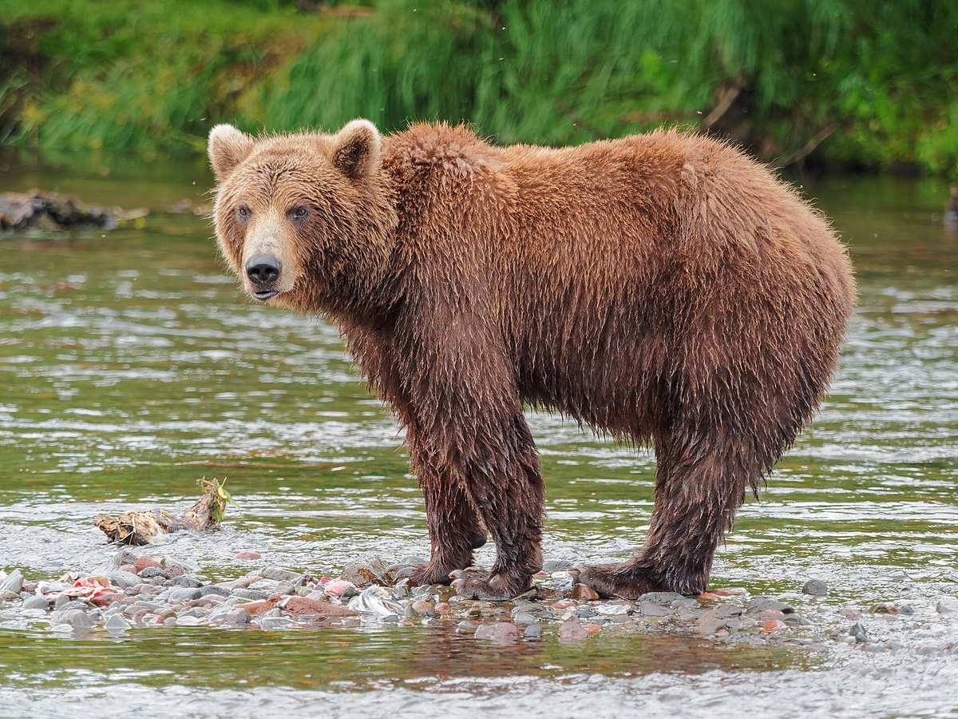
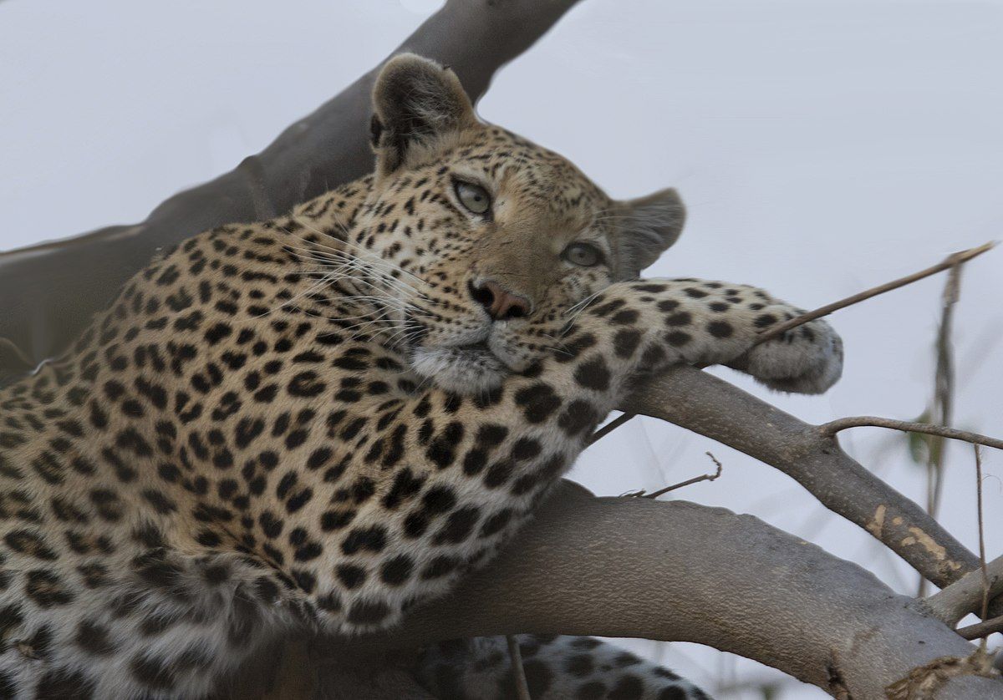
Resource abundance and HR: examples in literature
Brown bear, photo by Robert F. Tobler,
CC BY-SA 4.0, via Wikimedia Commons
Leopard, photo by Gregory "Slobirdr" Smith,
CC BY-SA 2.0, via Wikimedia Commons
HR size (km²)
Productivity (NDVI)
(Nilsen et al. 2005)

Slide 6
Resource abundance and HR : an abundance of evidence
Bista, D., G. S. Baxter, N. J. Hudson, S. T. Lama, and P. J. Murray. 2022. Effect of disturbances and habitat fragmentation on an arboreal habitat specialist mammal using GPS telemetry: A case of the red panda. Landscape Ecology 37:795–809.
Geremia, C., J. A. Merkle, D. R. Eacker, R. L. Wallen, P. J. White, M. Hebblewhite, and M. J. Kauffman. 2019. Migrating bison engineer the green wave. Proceedings of the National Academy of Sciences 116:25707–25713.
Herfindal, I., J. D. C. Linnell, J. Odden, E. B. Nilsen, and R. Andersen. 2005. Prey density, environmental productivity and home-range size in the Eurasian lynx (Lynx lynx). Journal of Zoology 265:63–71.
Lucherini, M., and S. Lovari. 1996. Habitat richness affects home range size in the red fox Vulpes vulpes. Behavioural Processes 36:103–105.
Nilsen, E. B., I. Herfindal, and J. D. C. Linnell. 2005. Can intra-specific variation in carnivore home-range size be explained using remote-sensing estimates of environmental productivity? Écoscience 12:68–75.
Relyea, R. A., R. K. Lawrence, and S. Demarais. 2000. Home Range of Desert Mule Deer: Testing the Body-Size and Habitat-Productivity Hypotheses. The Journal of Wildlife Management 64:146.
Rickbeil, G. J. M., J. A. Merkle, G. Anderson, M. P. Atwood, J. P. Beckmann, E. K. Cole, A. B. Courtemanch, et al. 2019. Plasticity in elk migration timing is a response to changing environmental conditions. Global Change Biology 25:2368–2381.
Williams-Guillen, K., C. McCann, J. C. Martinez Sanchez, and F. Koontz. 2006. Resource availability and habitat use by mantled howling monkeys in a Nicaraguan coffee plantation: Can agroforests serve as core habitat for a forest mammal? Animal Conservation 9:331–338.
…

Slide 7
Resource abundance and HR : common issues
Results reported as new findings
No unifying hypotheses

Slide 8
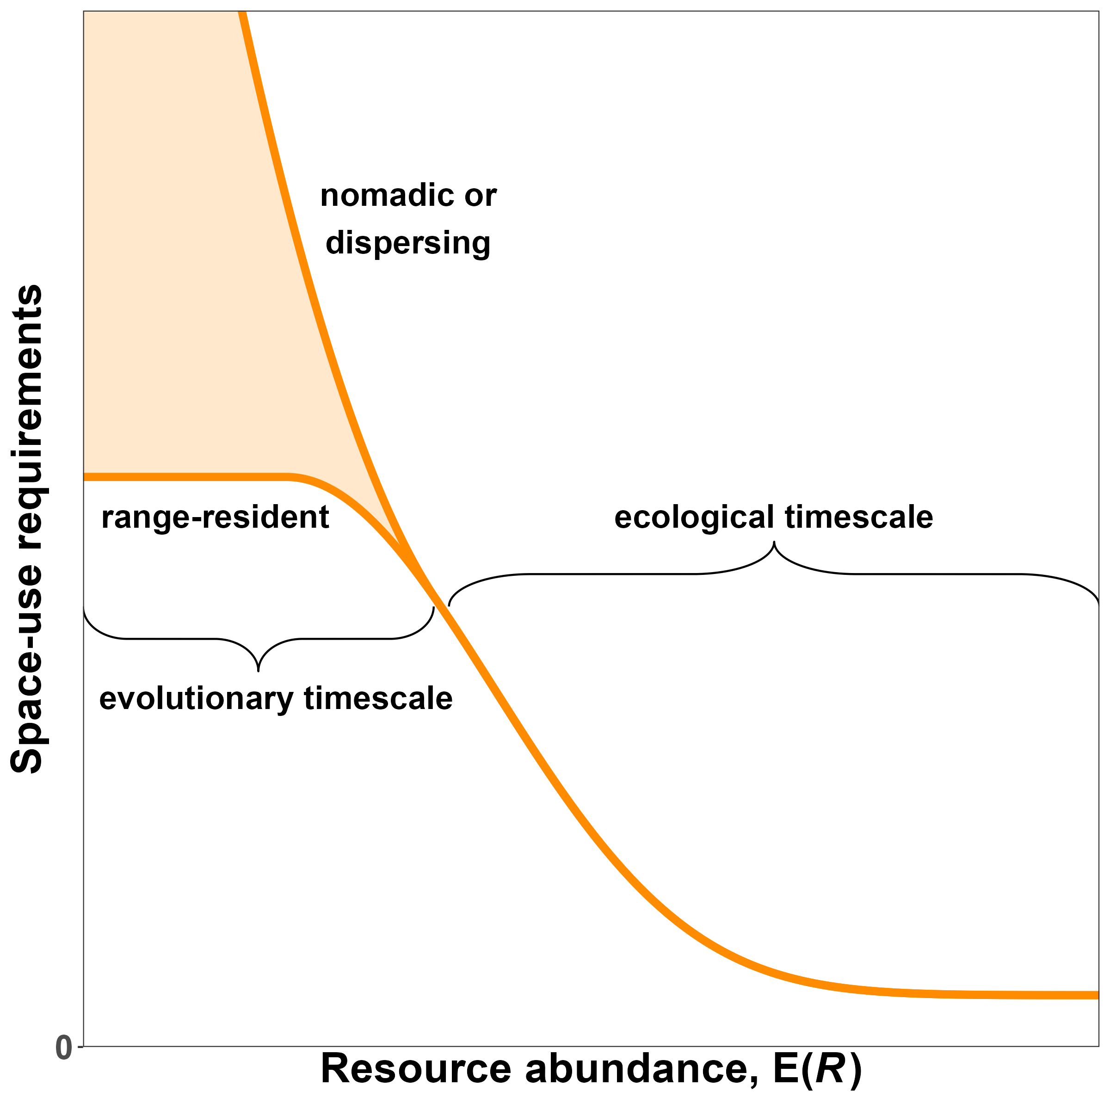
Resource abundance and HR: hypothesis
HR size (km²)
Forest cover (%)
HR size (km²)
HR size (km²)
Productivity (NDVI)

Slide 9
Resource unpredictability and HR

Slide 10
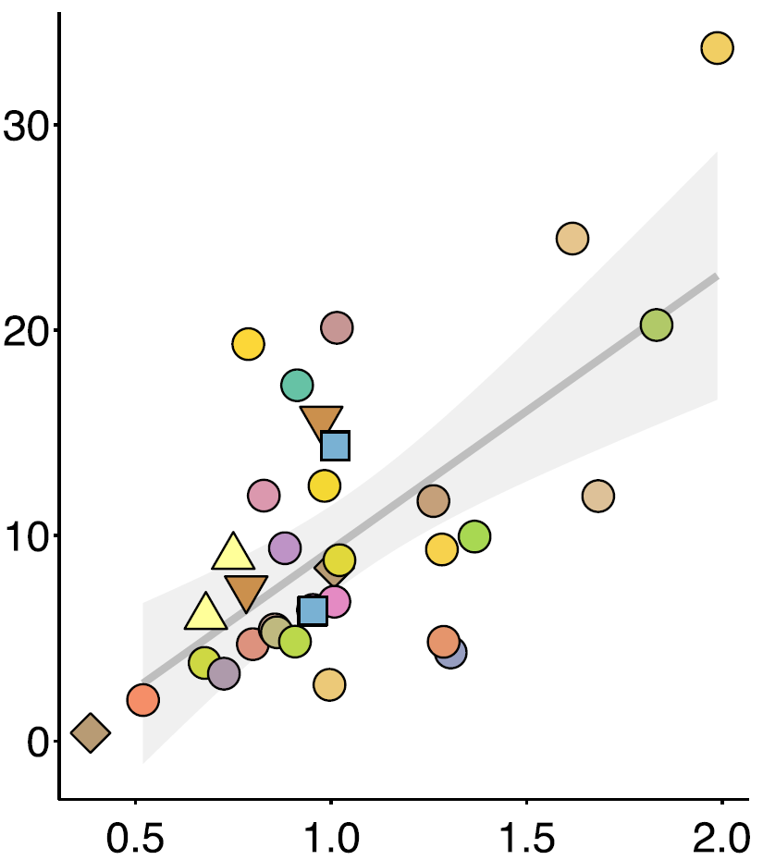
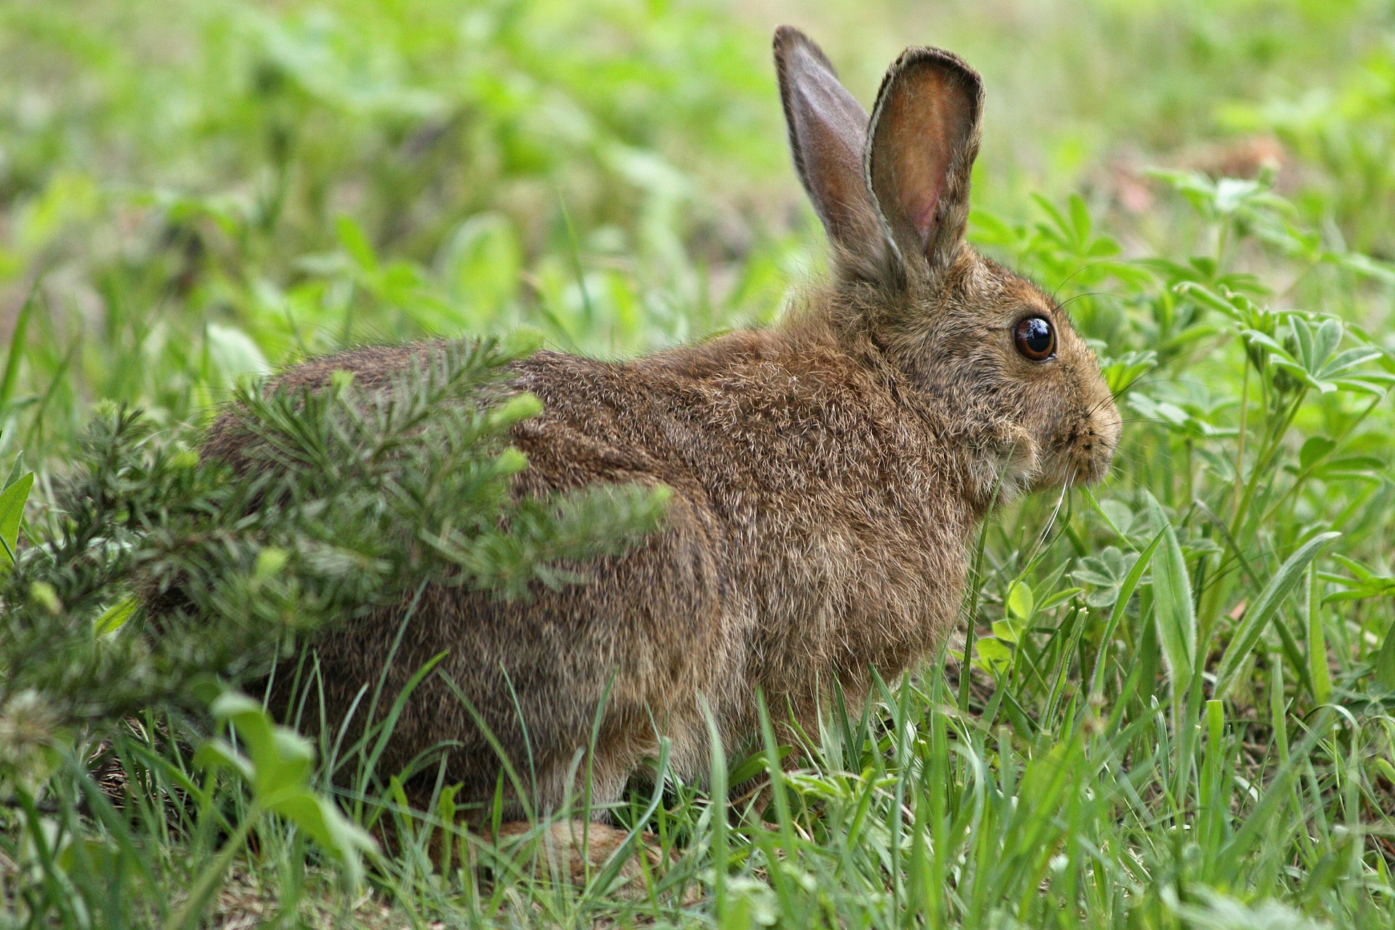
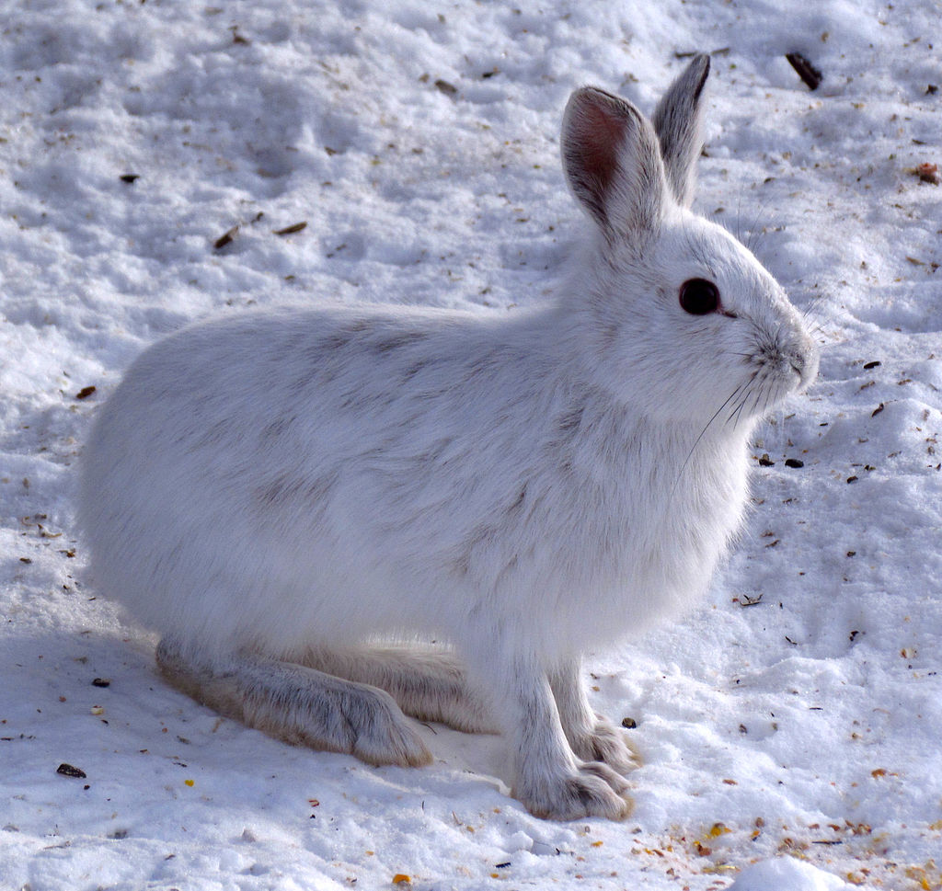
Resource unpredictability and HR: examples in literature
HR size (ha)
Nitrogen unpredictability (CV)
(Rizzuto et al. 2021)
Showshoe hares, photos by Walter Siegmund (top) and D. Gordon and
E. Robertson (bottom), CC BY-SA 3.0, via Wikimedia Commons

Slide 11
Resource unpredictability and HR : current evidence
Herfindal, I., J. D. C. Linnell, J. Odden, E. B. Nilsen, and R. Andersen. 2005. Prey density, environmental productivity and home-range size in the Eurasian lynx (Lynx lynx). Journal of Zoology 265:63–71.
Nilsen, E. B., I. Herfindal, and J. D. C. Linnell. 2005. Can intra-specific variation in carnivore home-range size be explained using remote-sensing estimates of environmental productivity? Écoscience 12:68–75.
Rizzuto M., Leroux S.J., Vander Wal E., Richmond I.C., Heckford T.R., Balluffi-Fry J., et al. (2021). Forage stoichiometry predicts the home range size of a small terrestrial herbivore. Oecologia 197, 327–338.

Slide 12
Resource unpredictability and HR: common issues
Results reported as new findings
No unifying hypotheses

Slide 13
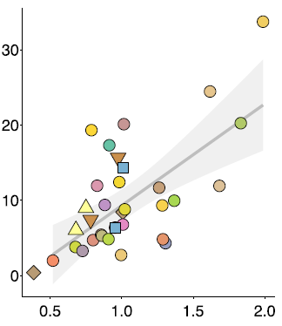
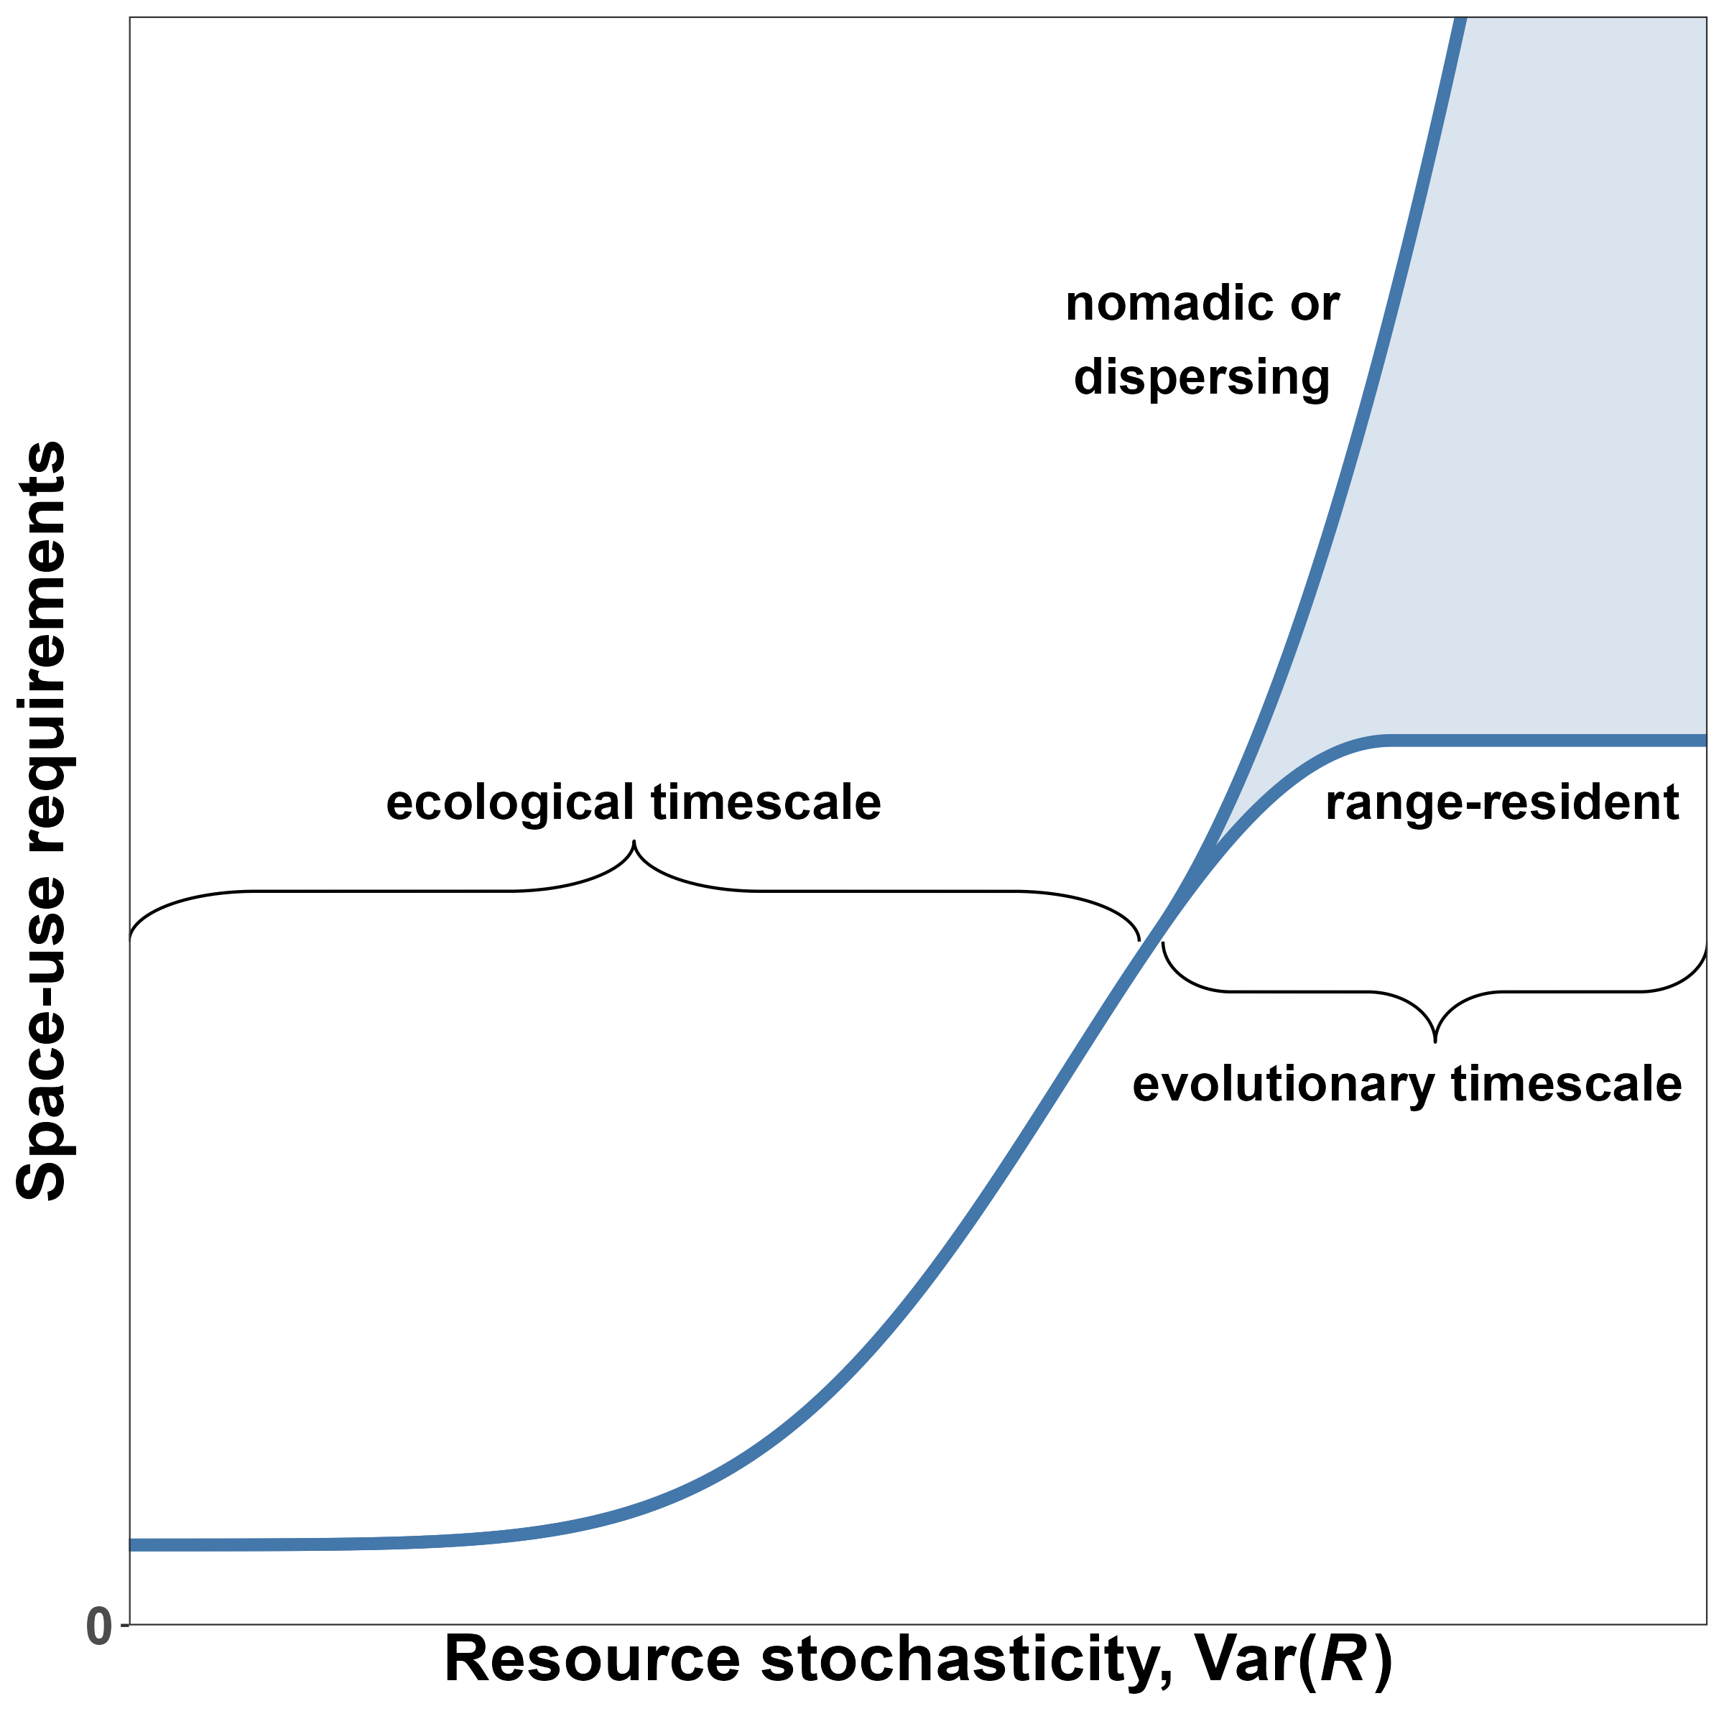
Resource unpredictability and HR: a unifying framework
HR ize (ha)
Nitrogen unpredictability
Showshoe hares, photos by D. Gordon and
E. Robertson (bottom), CC BY-SA 3.0, via Wikimedia Commons

Slide 14
New generalized hypotheses

Slide 15
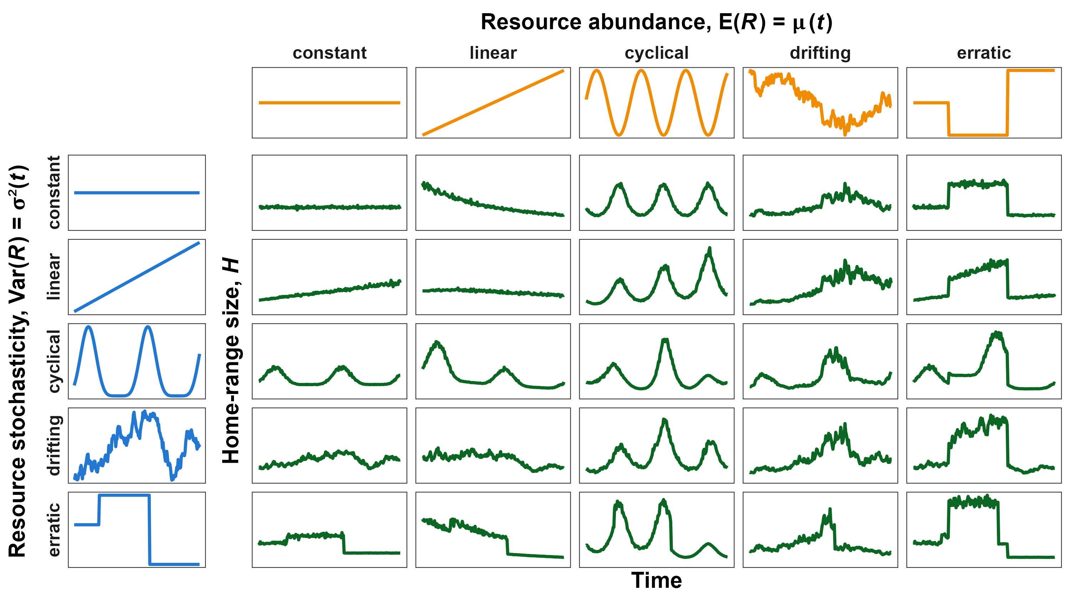
Chapter 1: Simulating the relationships

Slide 16
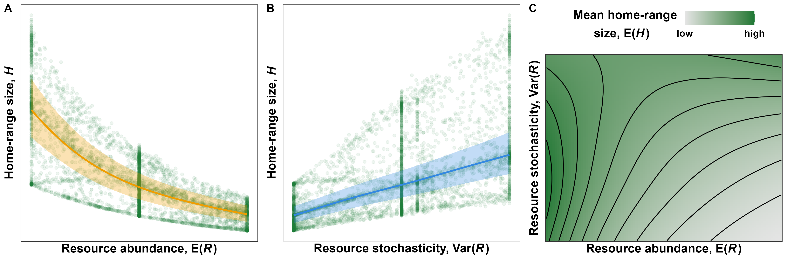
Chapter 1: E(R) and Var(R) both affect E(H)

Slide 17
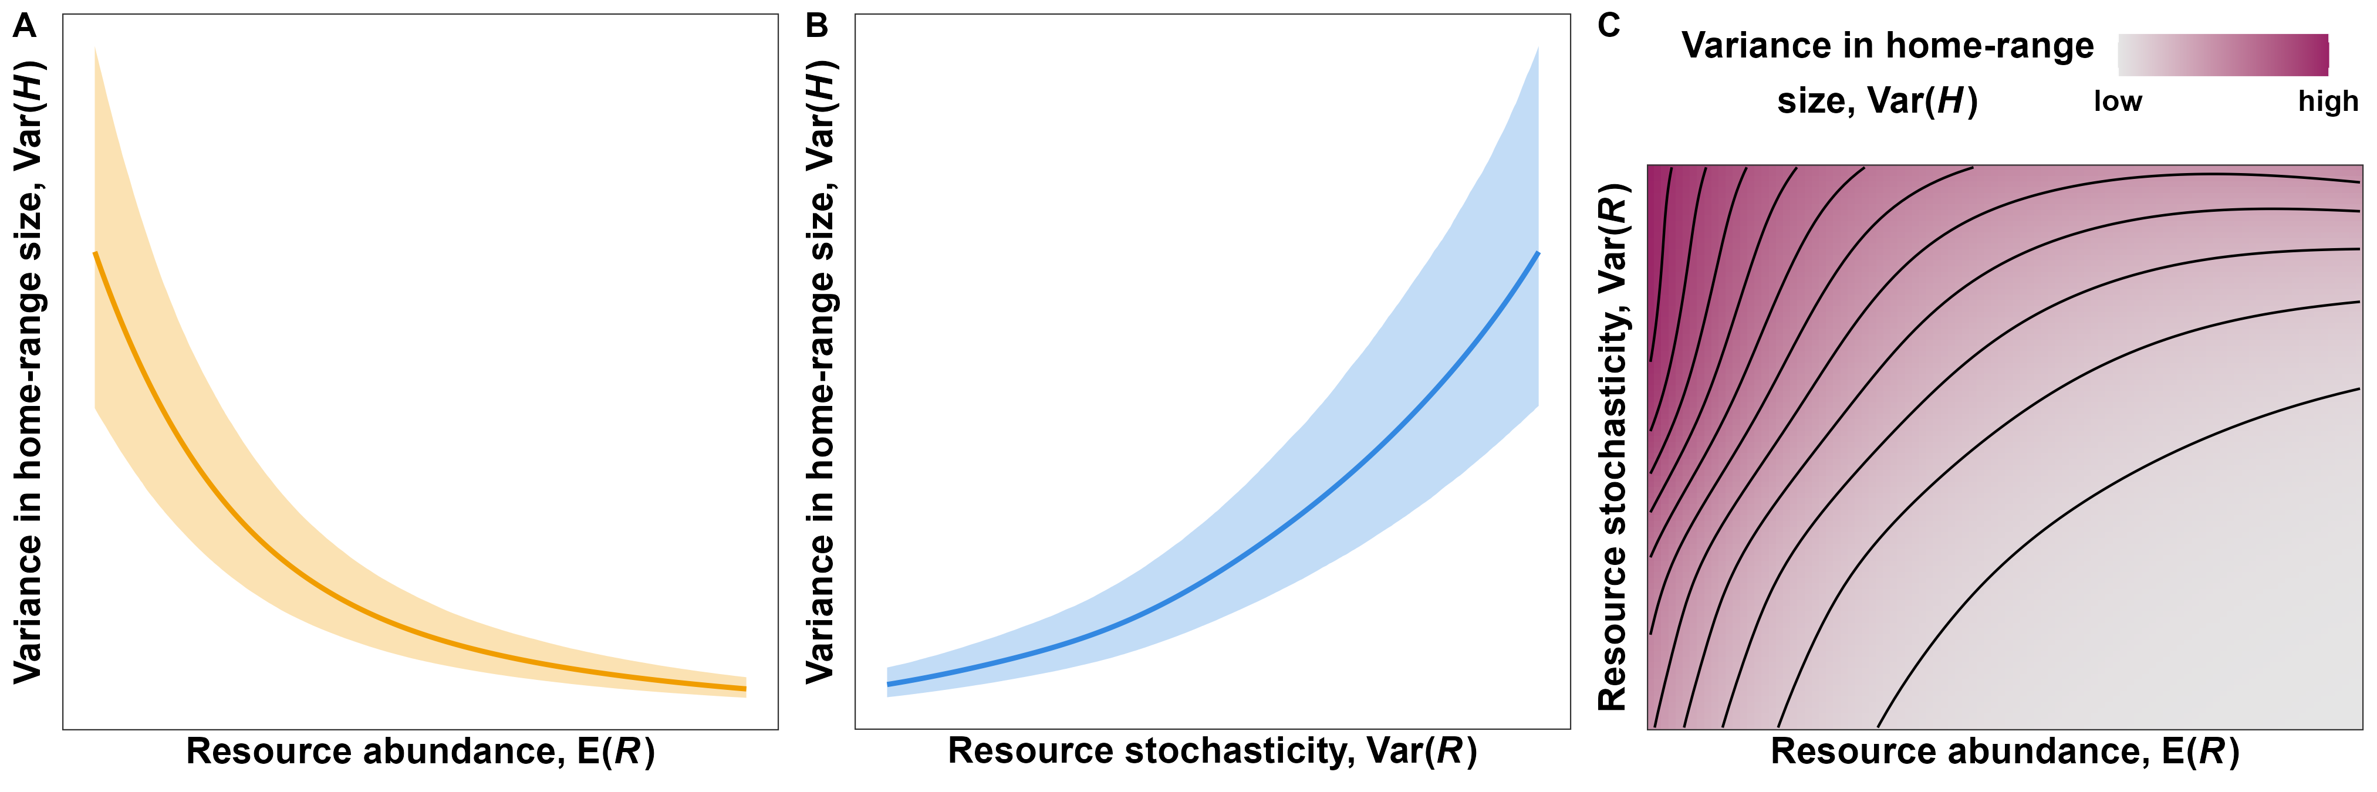
Chapter 1: E(R) and Var(R) both affect Var(H)

Slide 18
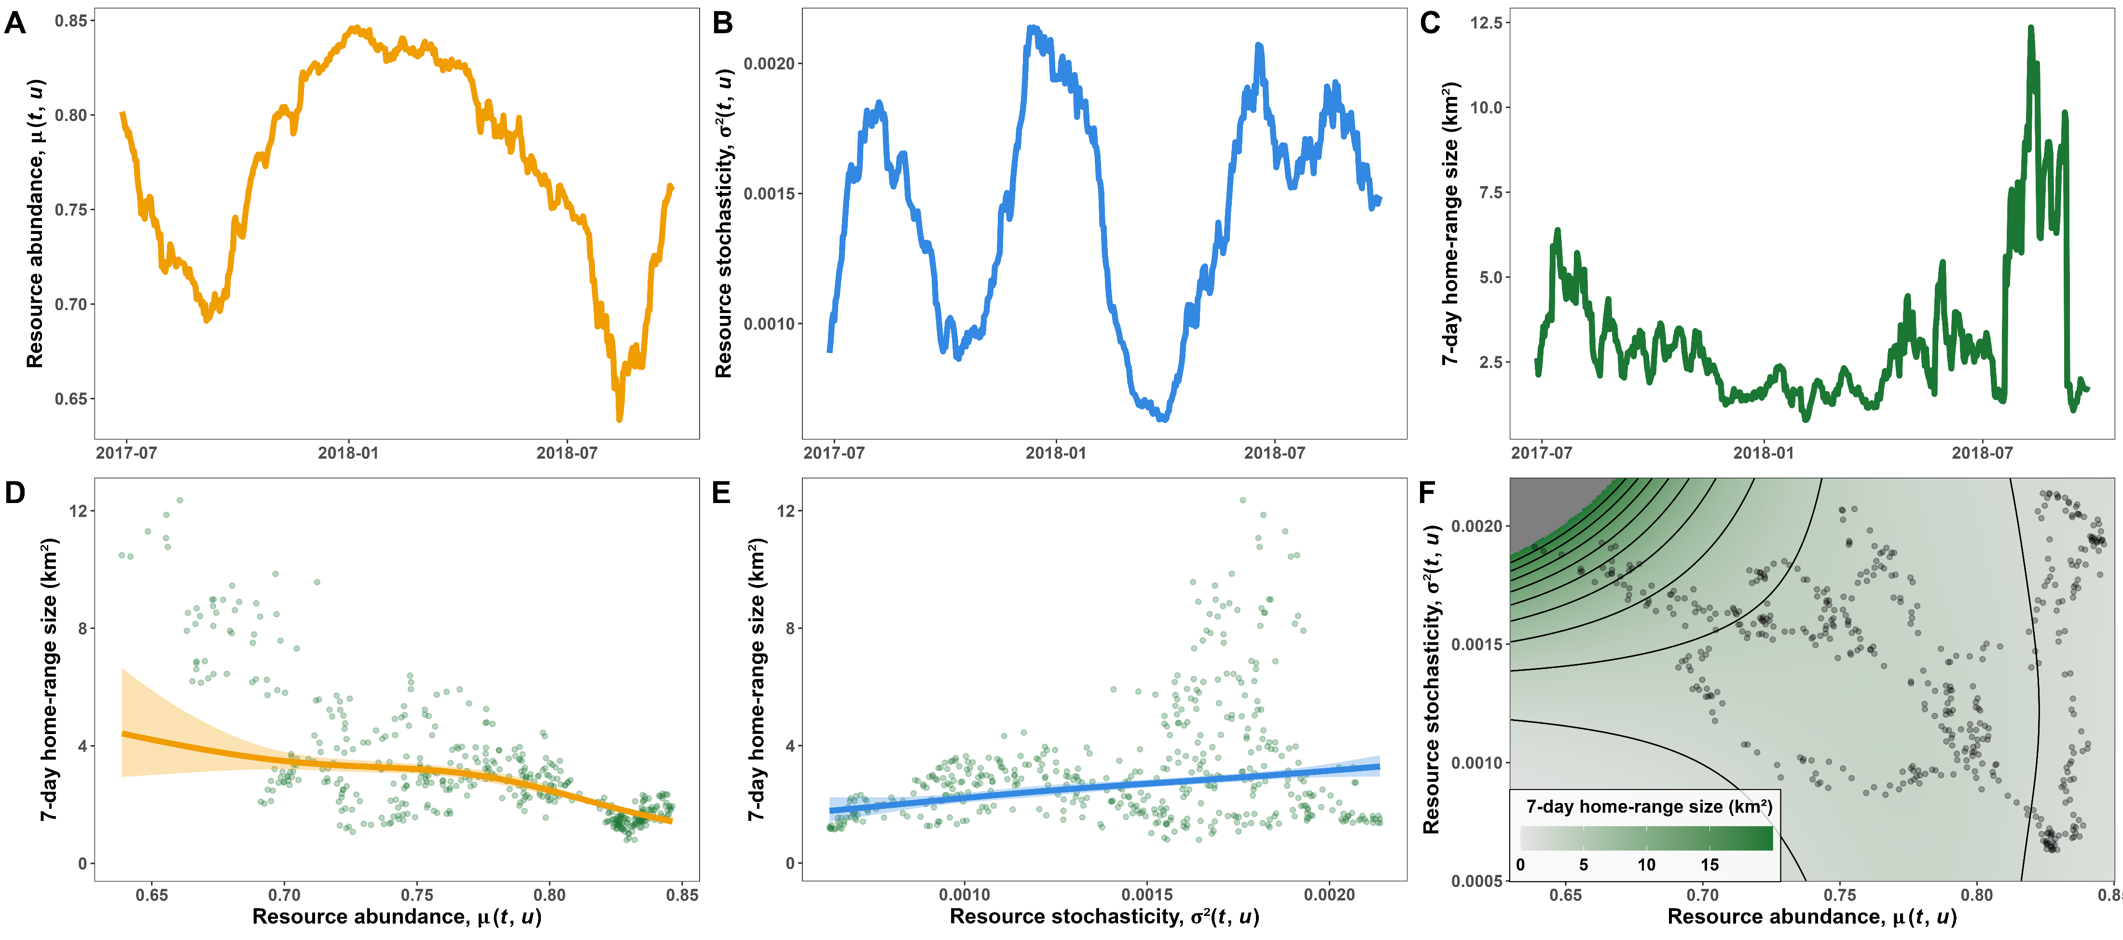
Chapter 1: Testing the hypotheses with real data
Preprint available at: https://www.biorxiv.org/content/10.1101/2023.11.03.565563v1

Slide 19
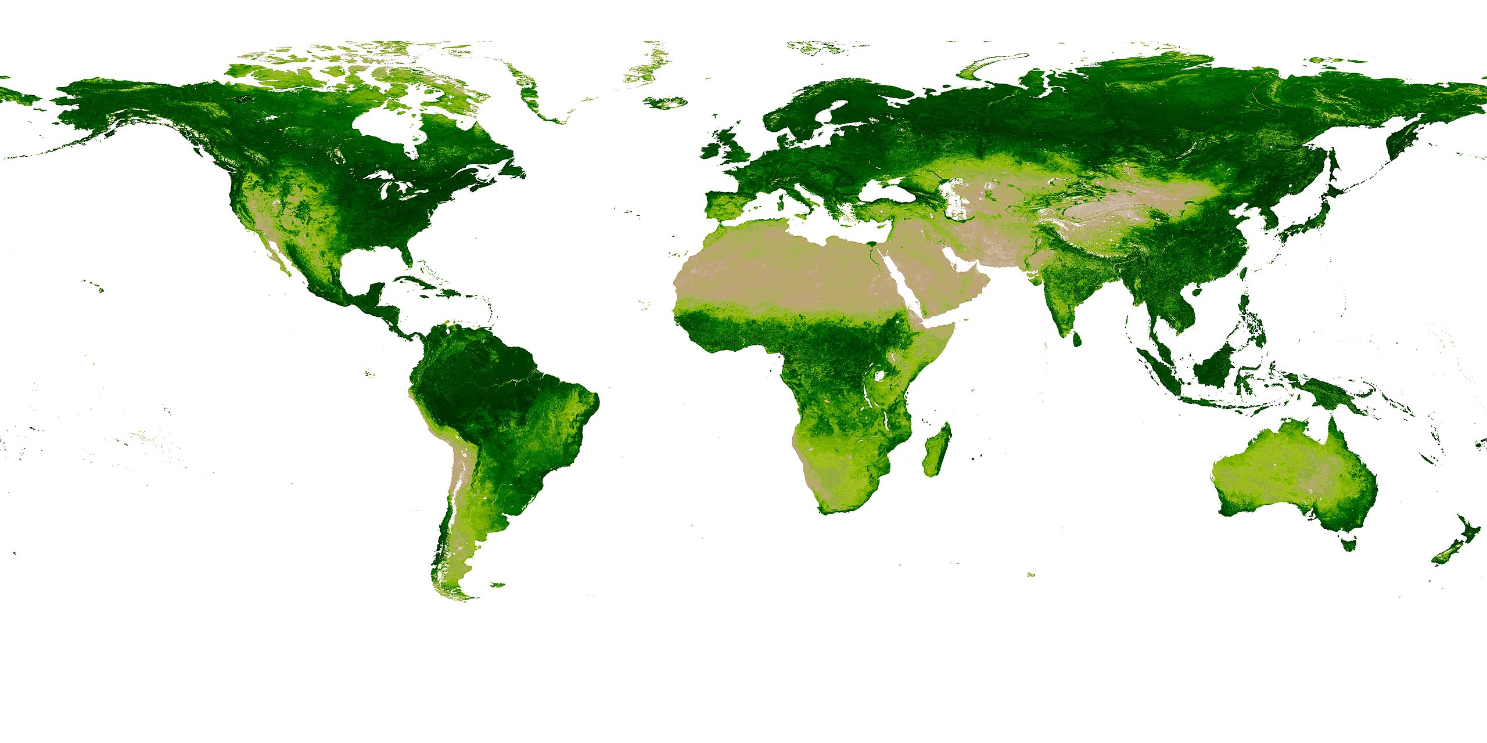
Chapter 2: Estimating abundance and unpredictability world-wide
NDVI:
Productivity
Seasonality
Weather, climate
Extreme events (burns, floods)
Does not account for prey or competitors
AVHRR data: daily, 0.5-degree rasters since 1980s (>900 GB!)
Map of NDVI by Ivan Shmakov (cropped)

Slide 20
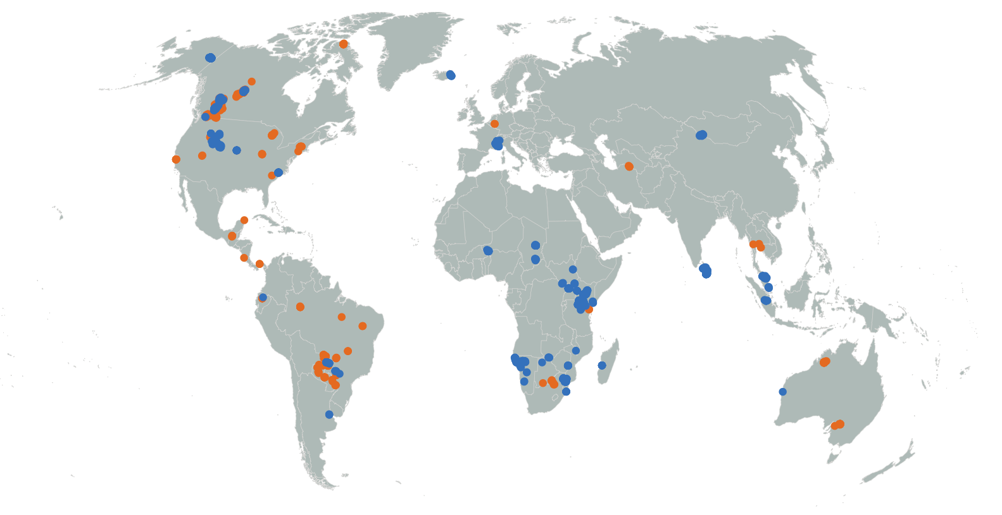
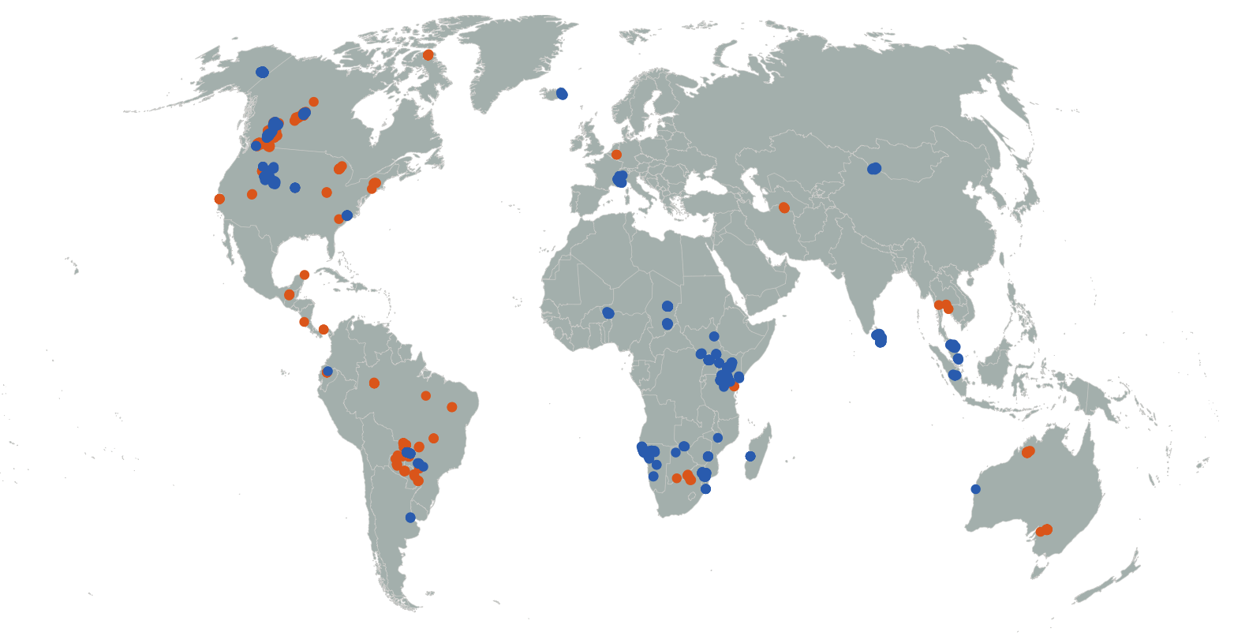
Chapter 3: Using a sample size greater than n = 1 animal
Repeat HR analysis for:
3,000+ animals
85+ species
Estimate behaviors:
Between populations
Between species
Test for common behavior

Slide 21
Chapter 3: Generalizing relationships (with energetics scaling with mass)

Slide 22
What will BC look like in 100 years?

Slide 23
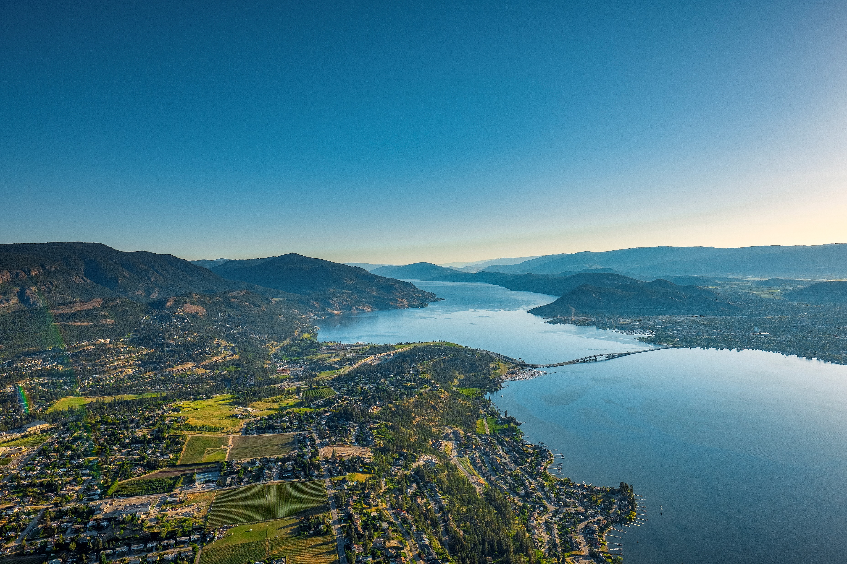
© University of British Columbia Okanagan

Slide 24
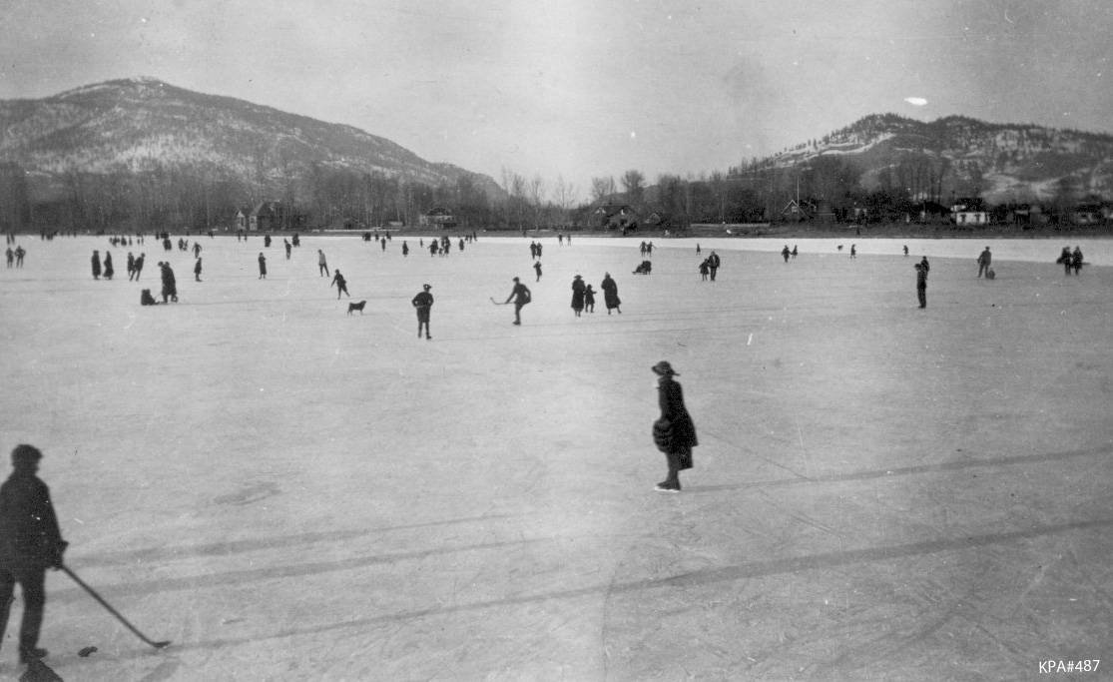
Things are not what they used to be 100 years ago
Kelowna Public Archives: KPA #487

Slide 25
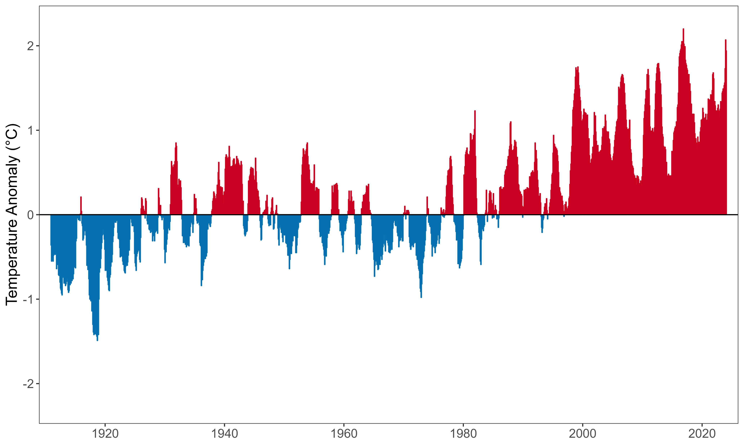
The climate is warming rapidly
(Relative to the 1910-2000 average)

Slide 26
How does temperature affect mammal movement in BC?

Slide 27
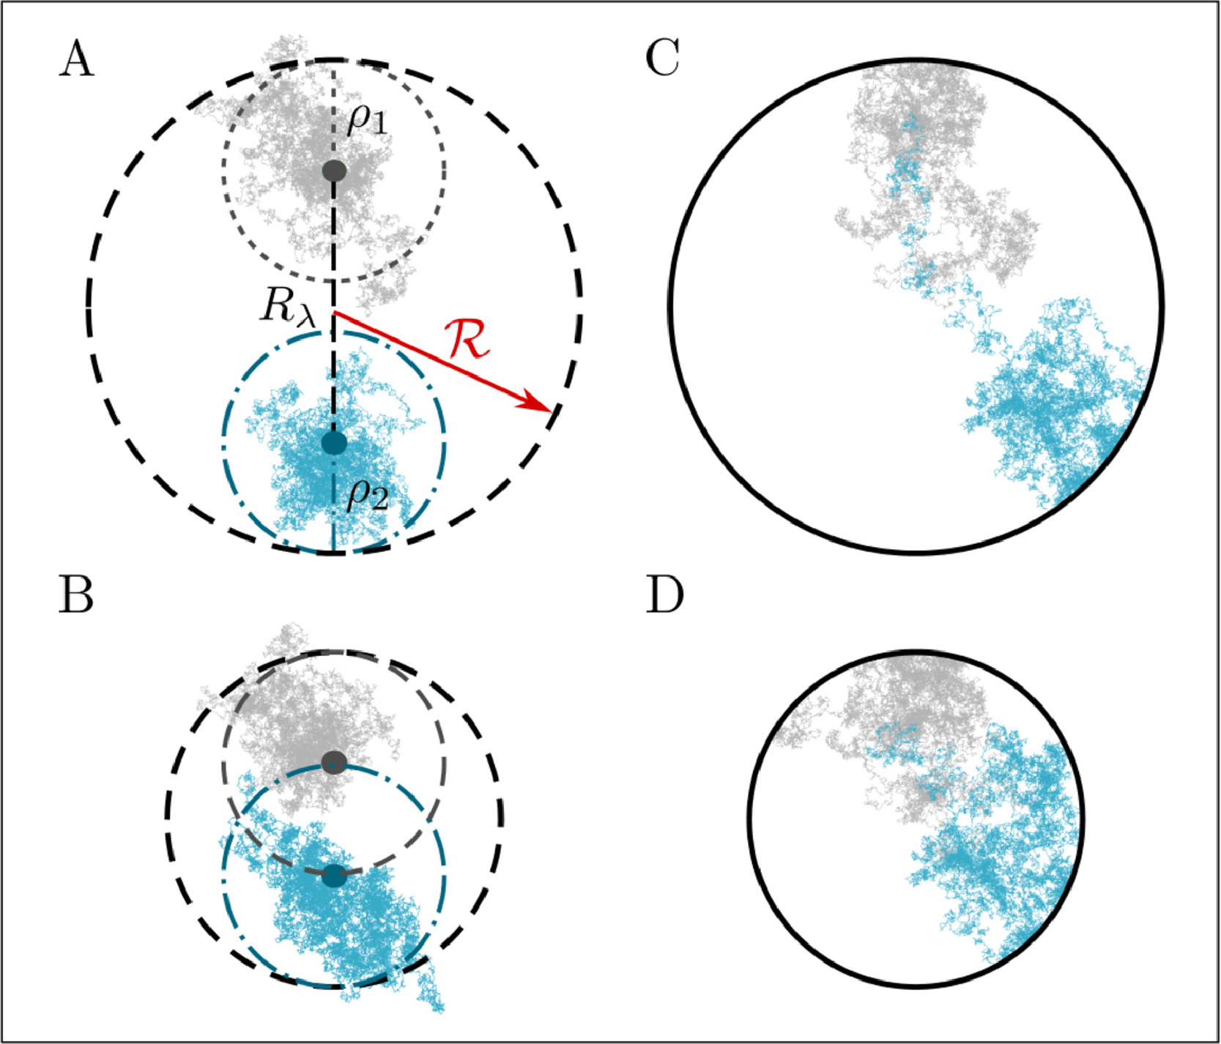
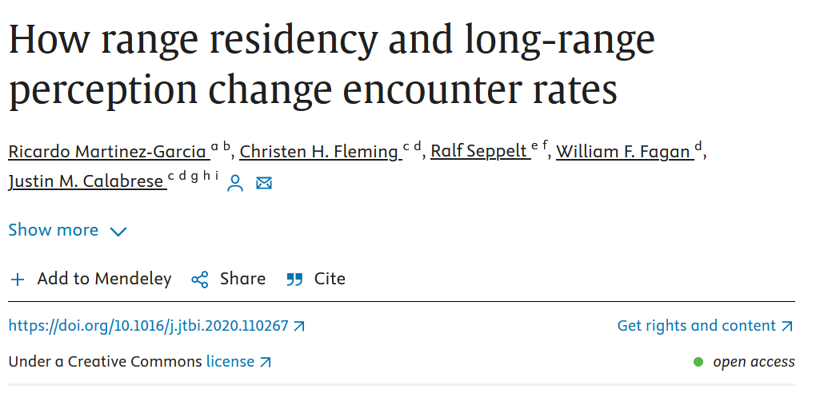
Encounter rates depend on movement rates

Slide 28
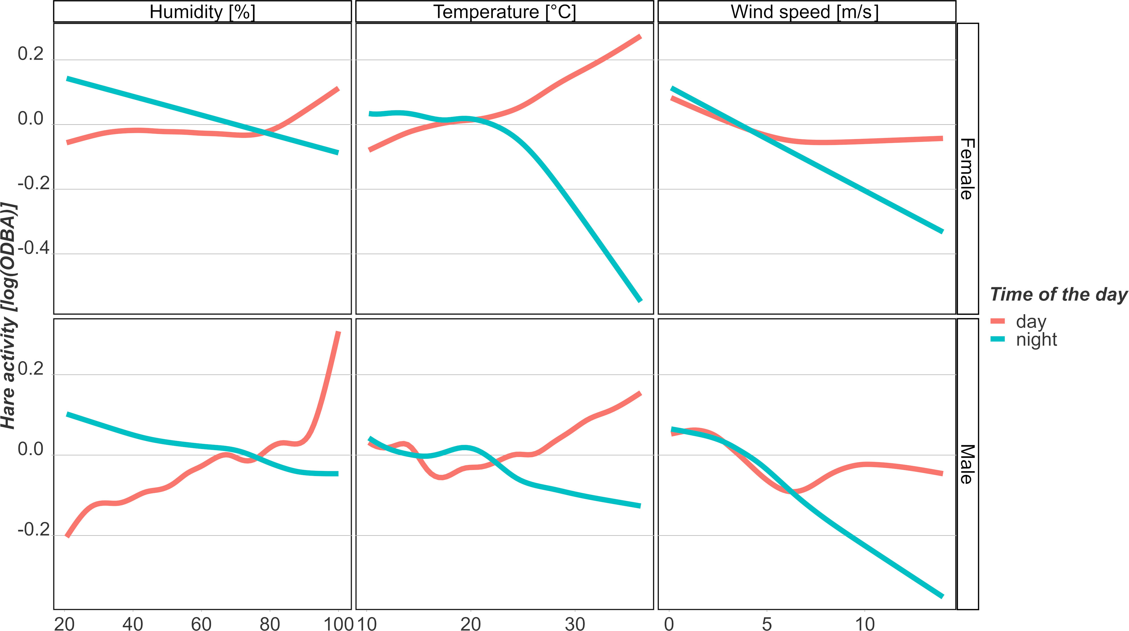
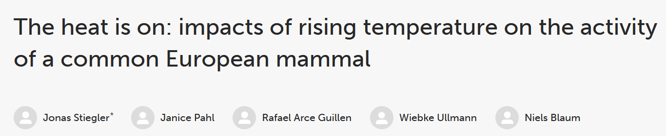

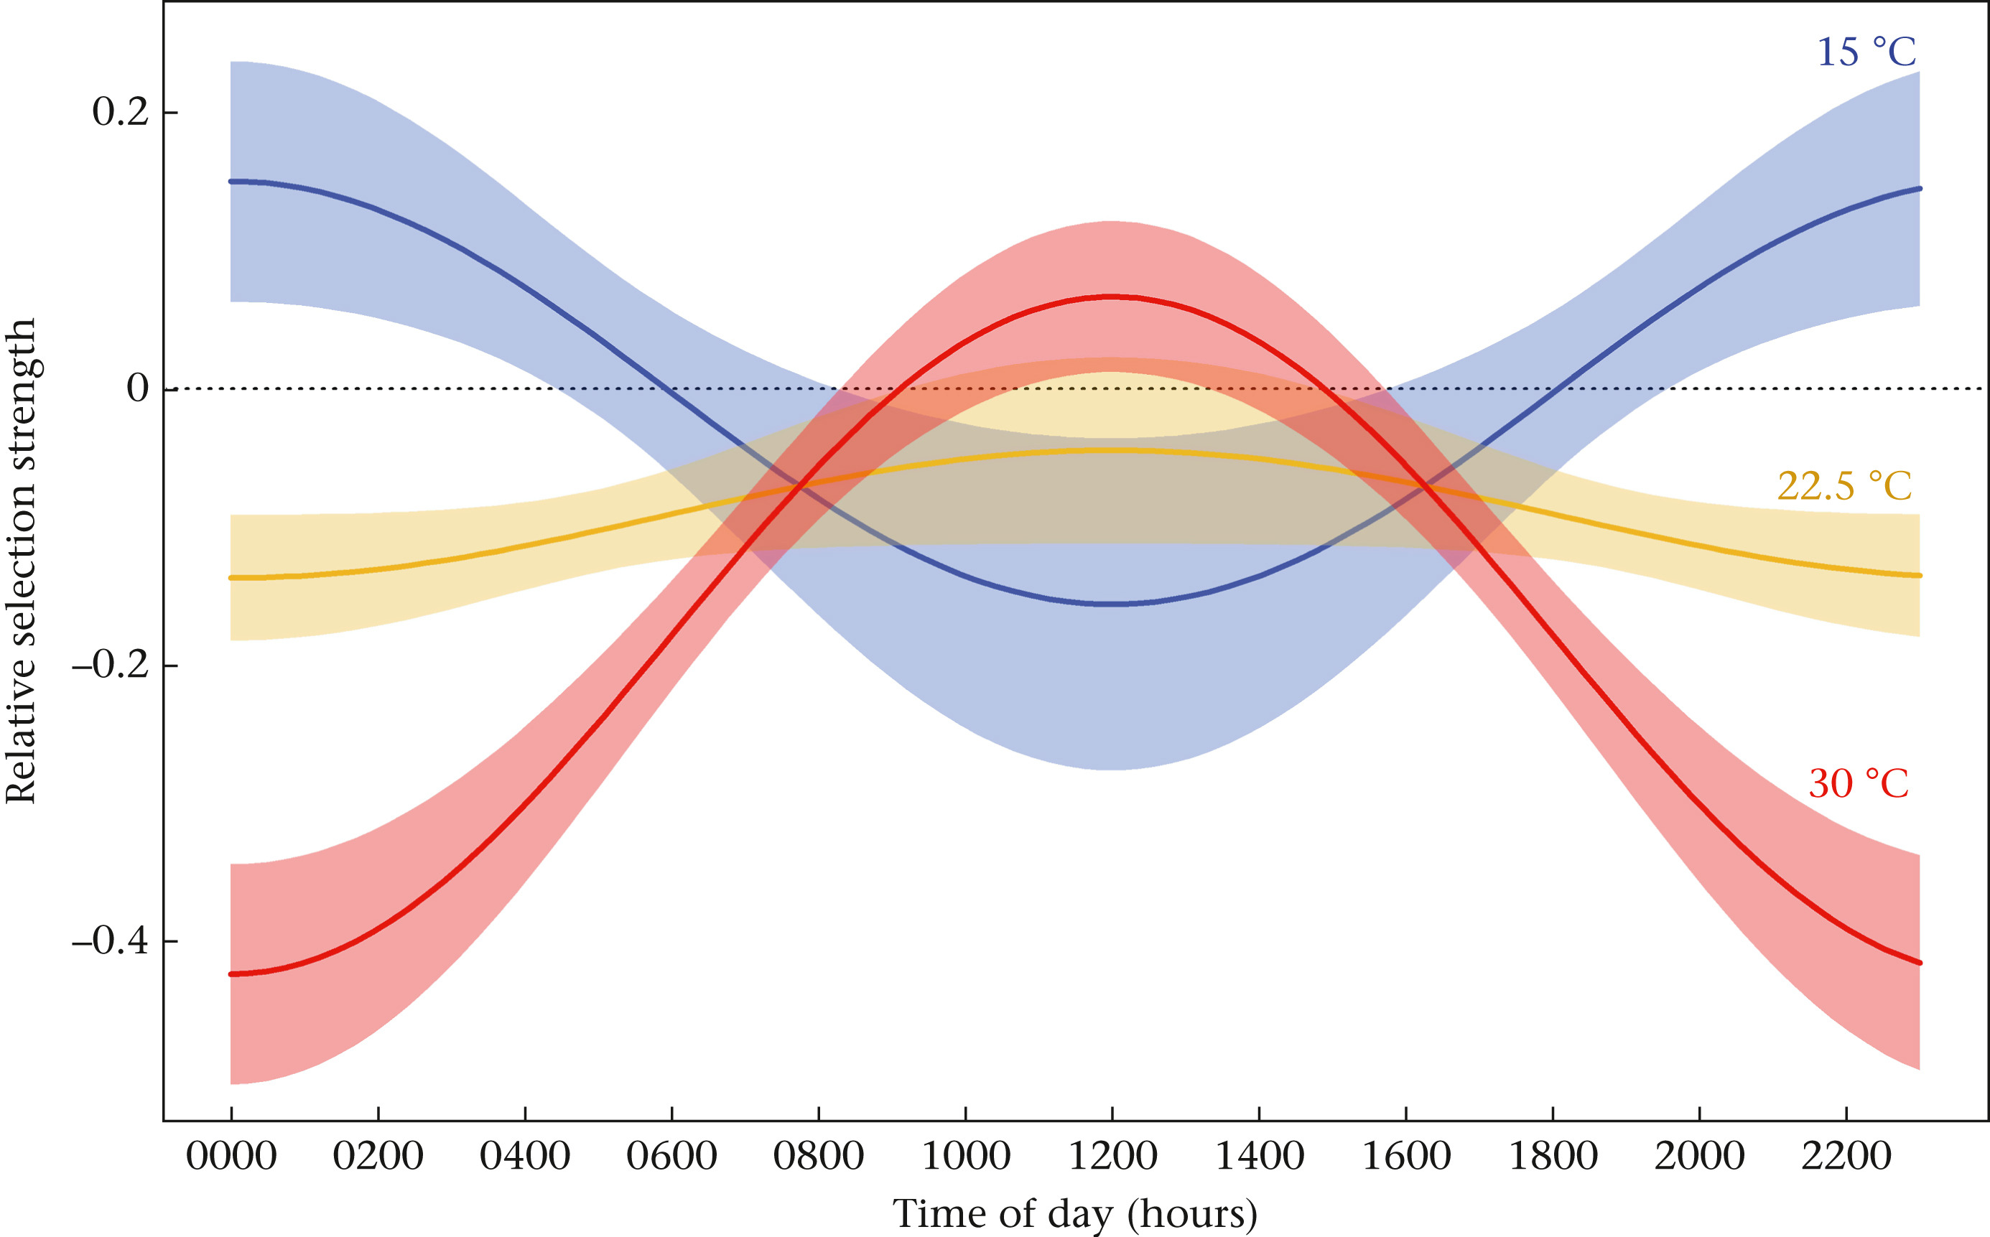
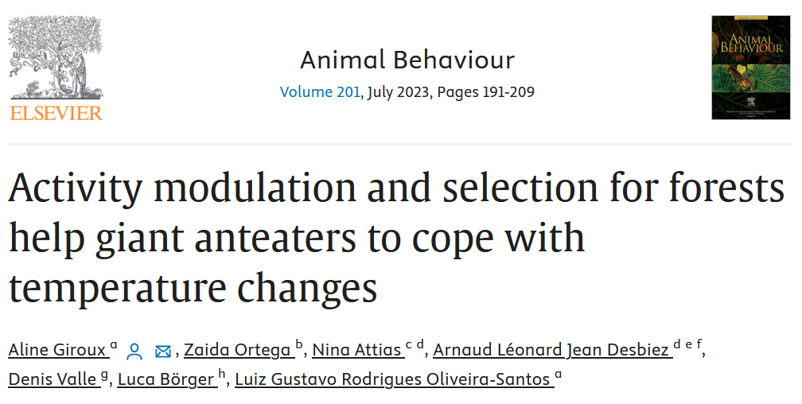
Temperature affects movement behavior

Slide 29
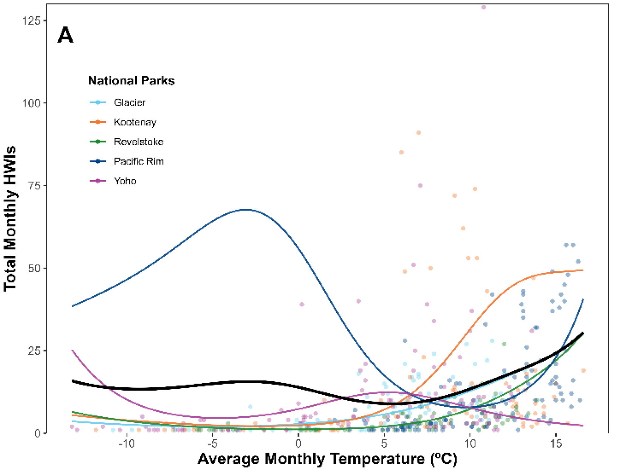
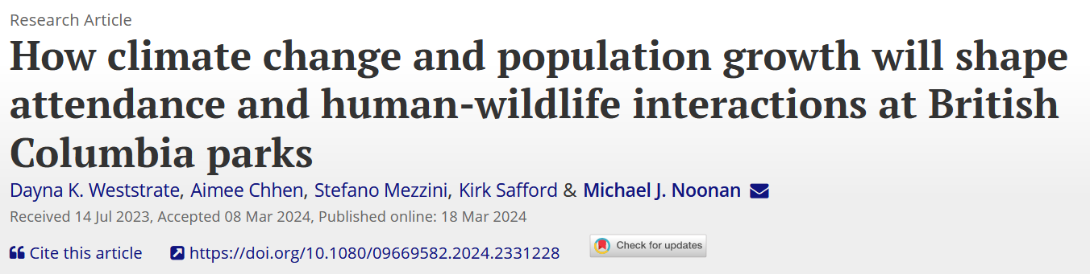
Temperature affects human-wildlife interactions

Slide 30
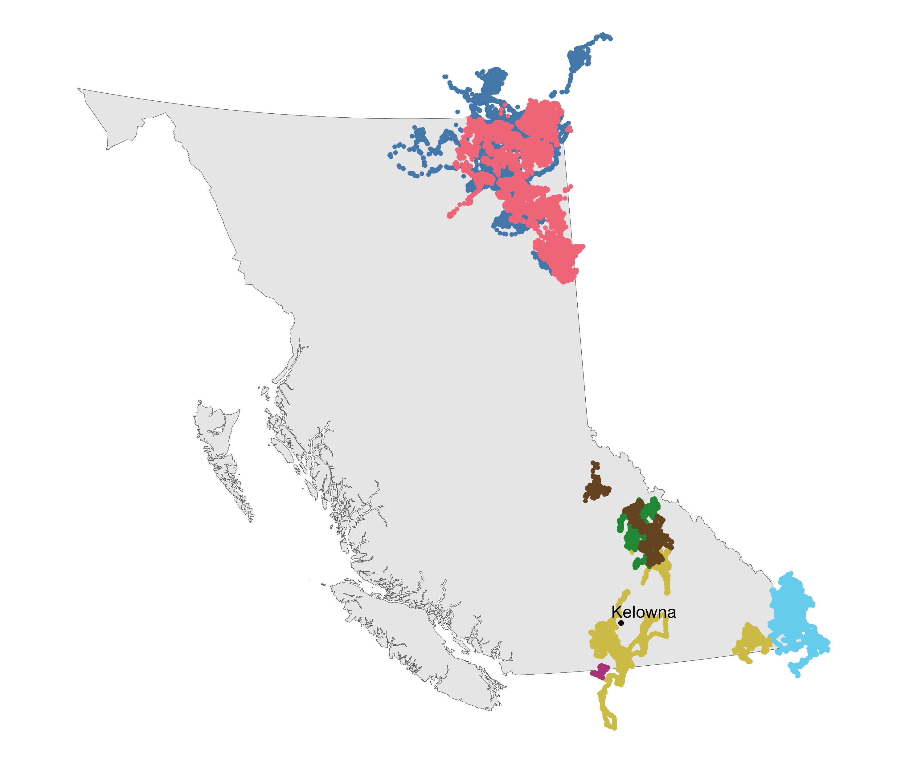



Slide 31
How does temperature affect how often mammals move?

Slide 32
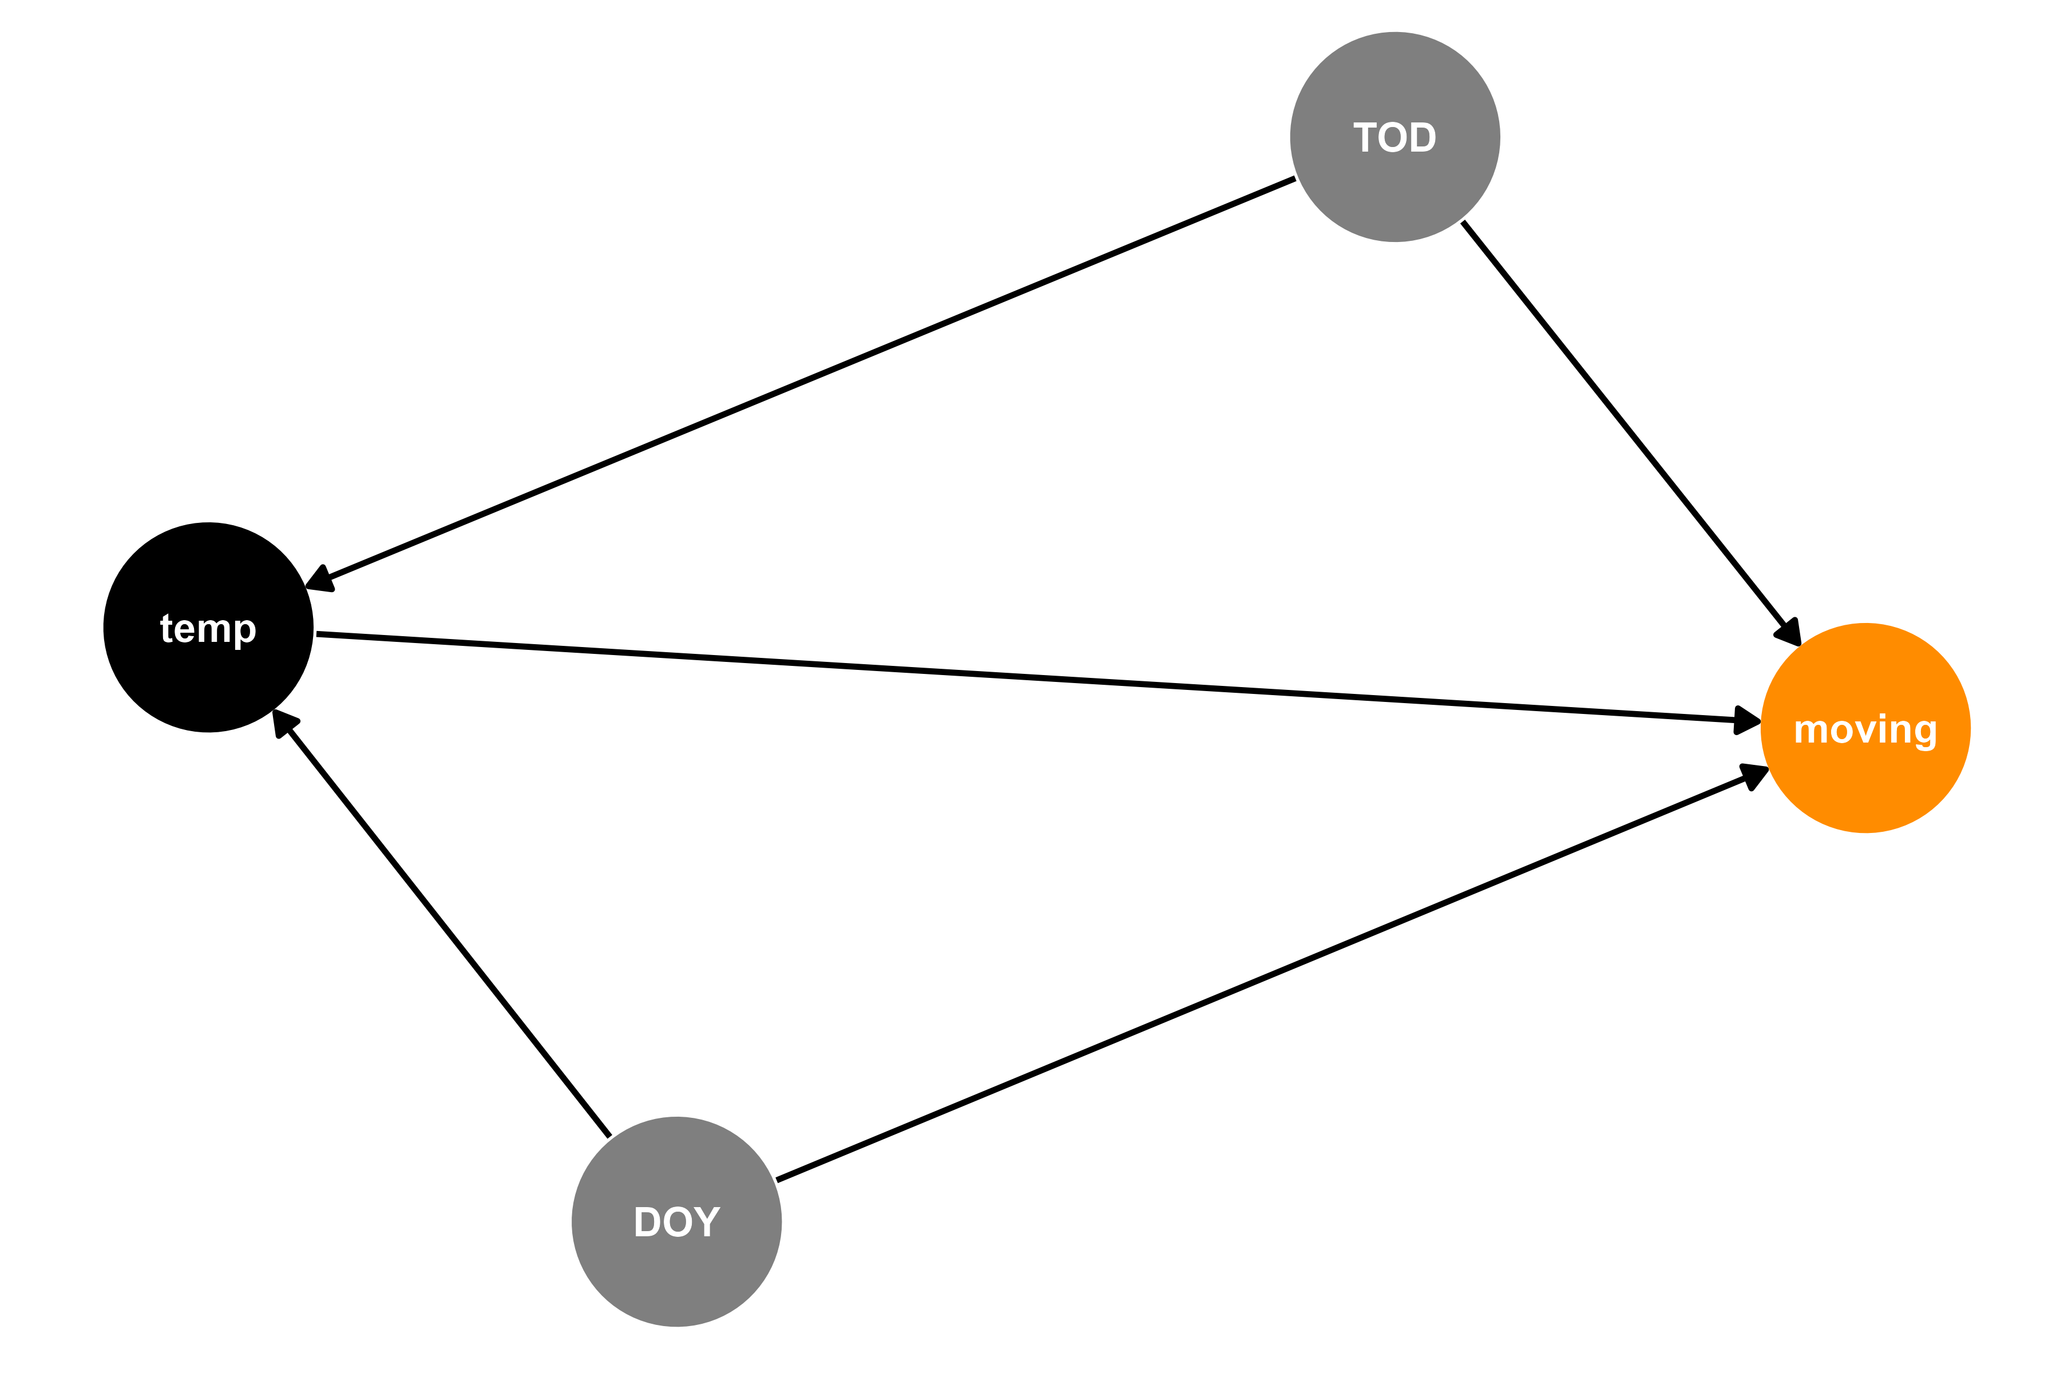



Modeling how often mammals move

Slide 33
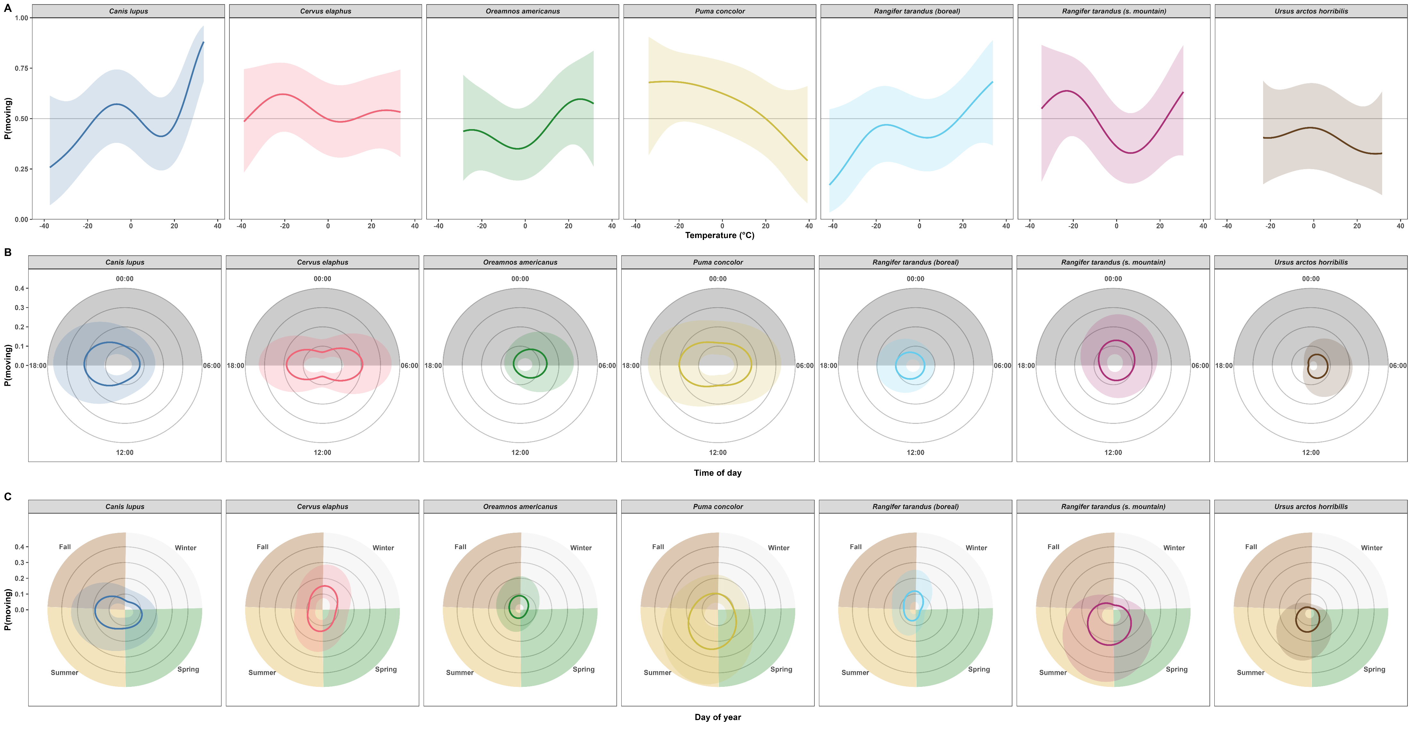
Estimate the effects using an HGAM…

Slide 34
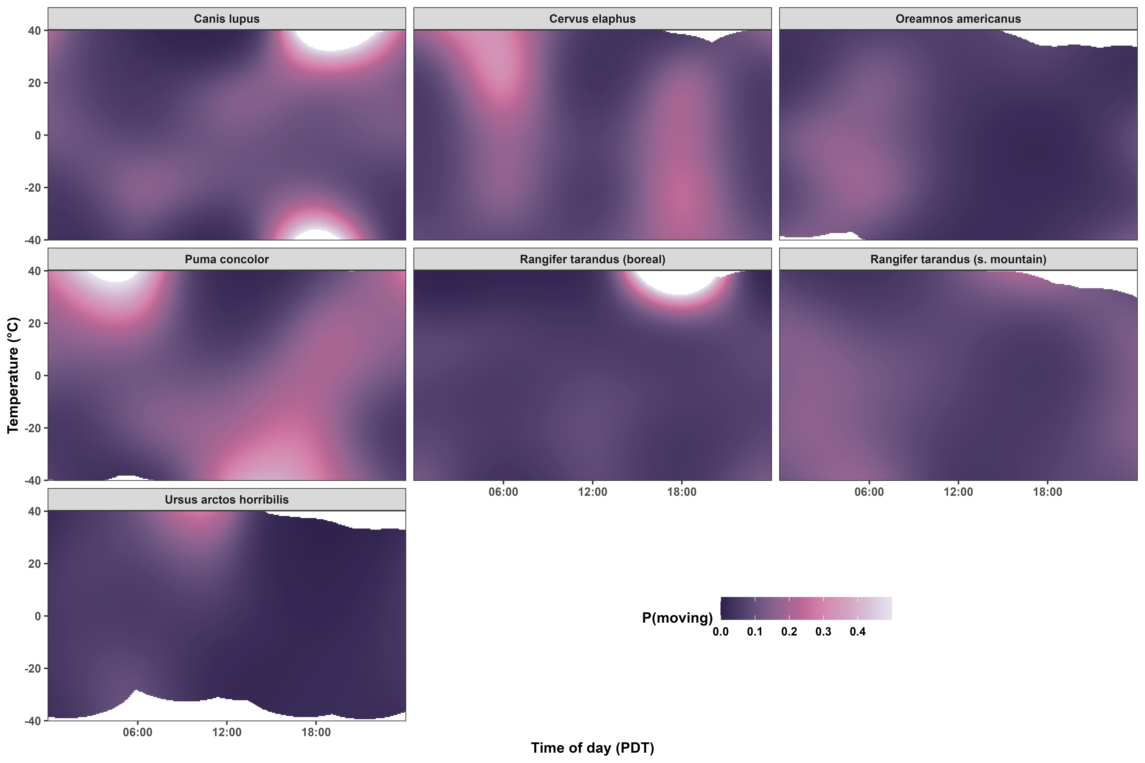
Effects of temperature depend on time of day

Slide 35
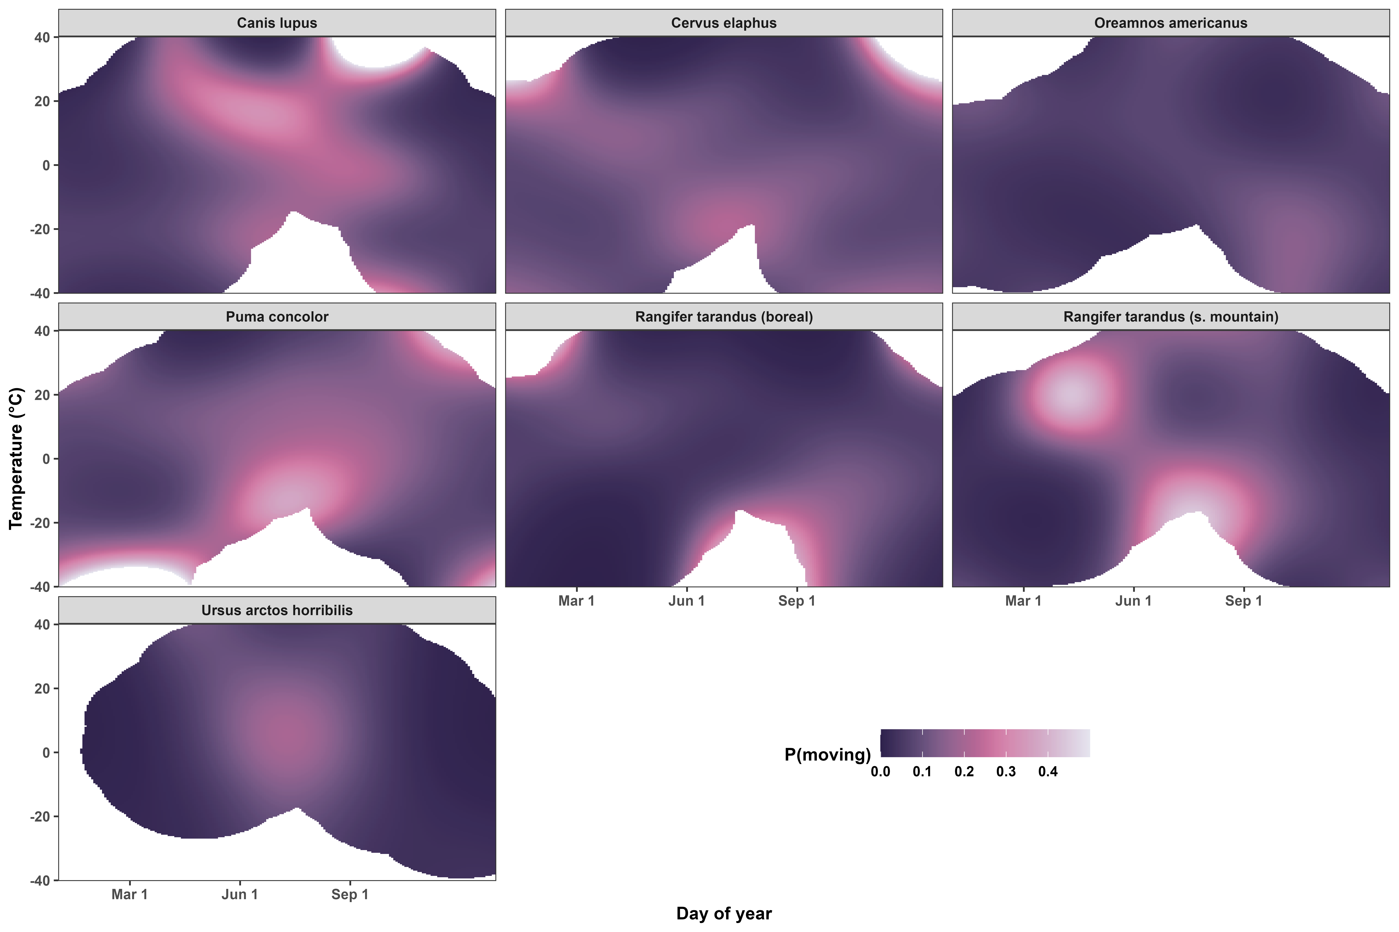
Effects of temperature depend on day of year

Slide 36
How does temperature affect how fast mammals move?

Slide 37

Modeling how fast mammals move

Slide 38
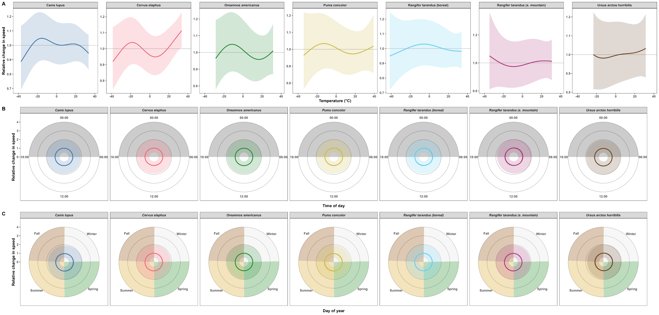
Estimate the effects using an HGAM…

Slide 39
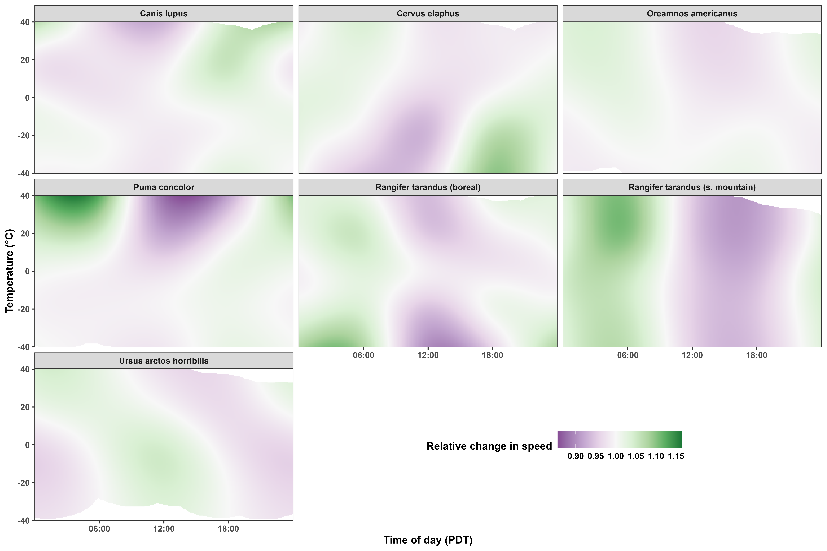
Effects of temperature depend on time of day

Slide 40
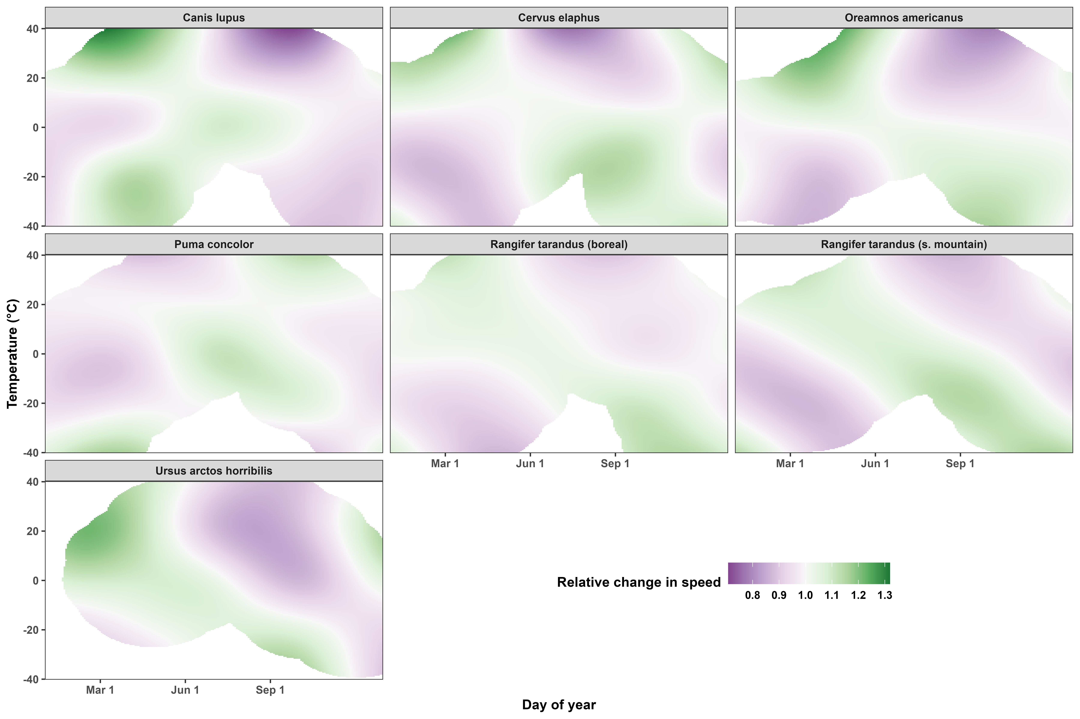
Effects of temperature depend on day of year

Slide 41
Temperature and habitat selection

Slide 42
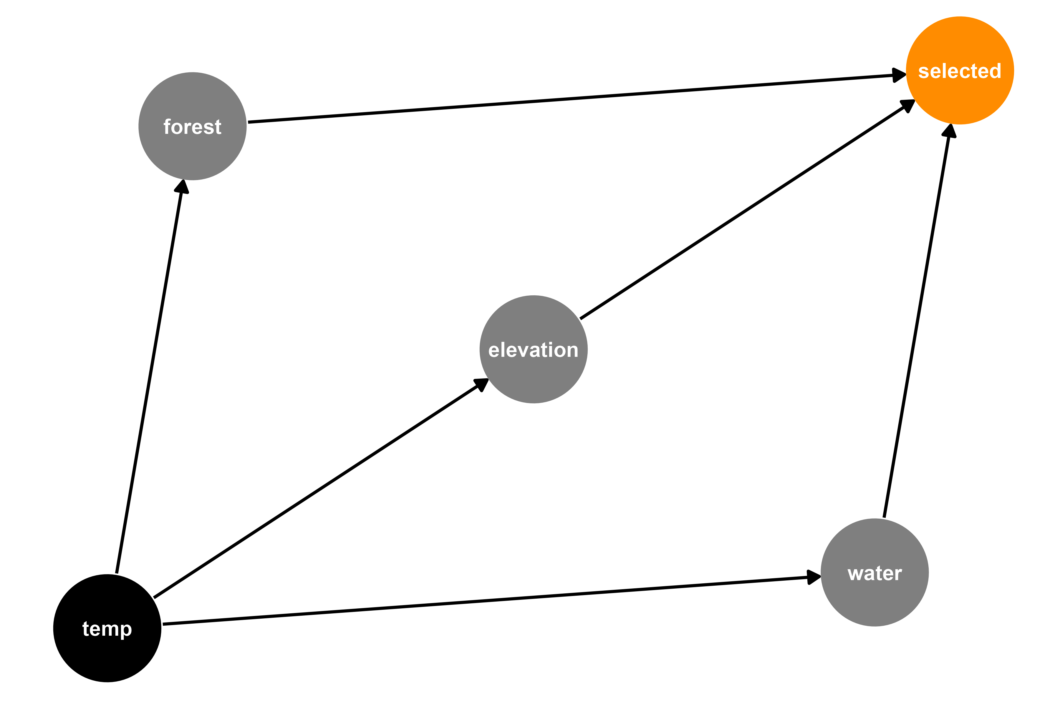



Modeling where boreal caribou move: Resource Selection Function (RSF)

Slide 43
Work in progress…

Slide 44
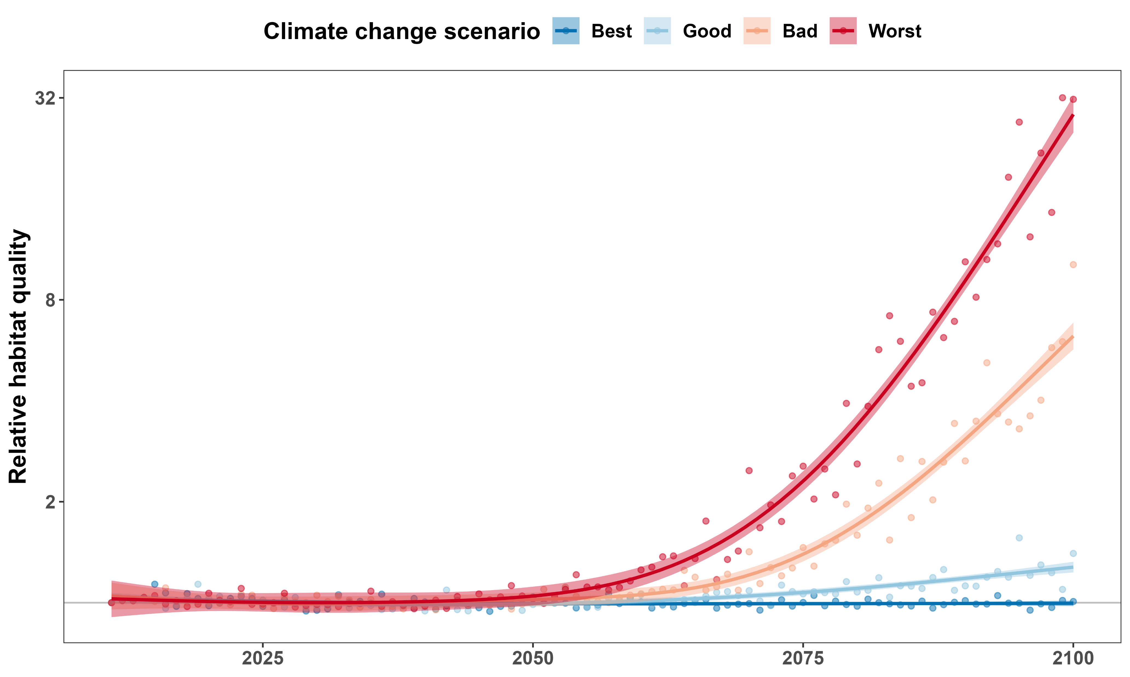
Habitat quality will depend strongly on climate change scenario
Like
Dislike

Slide 45
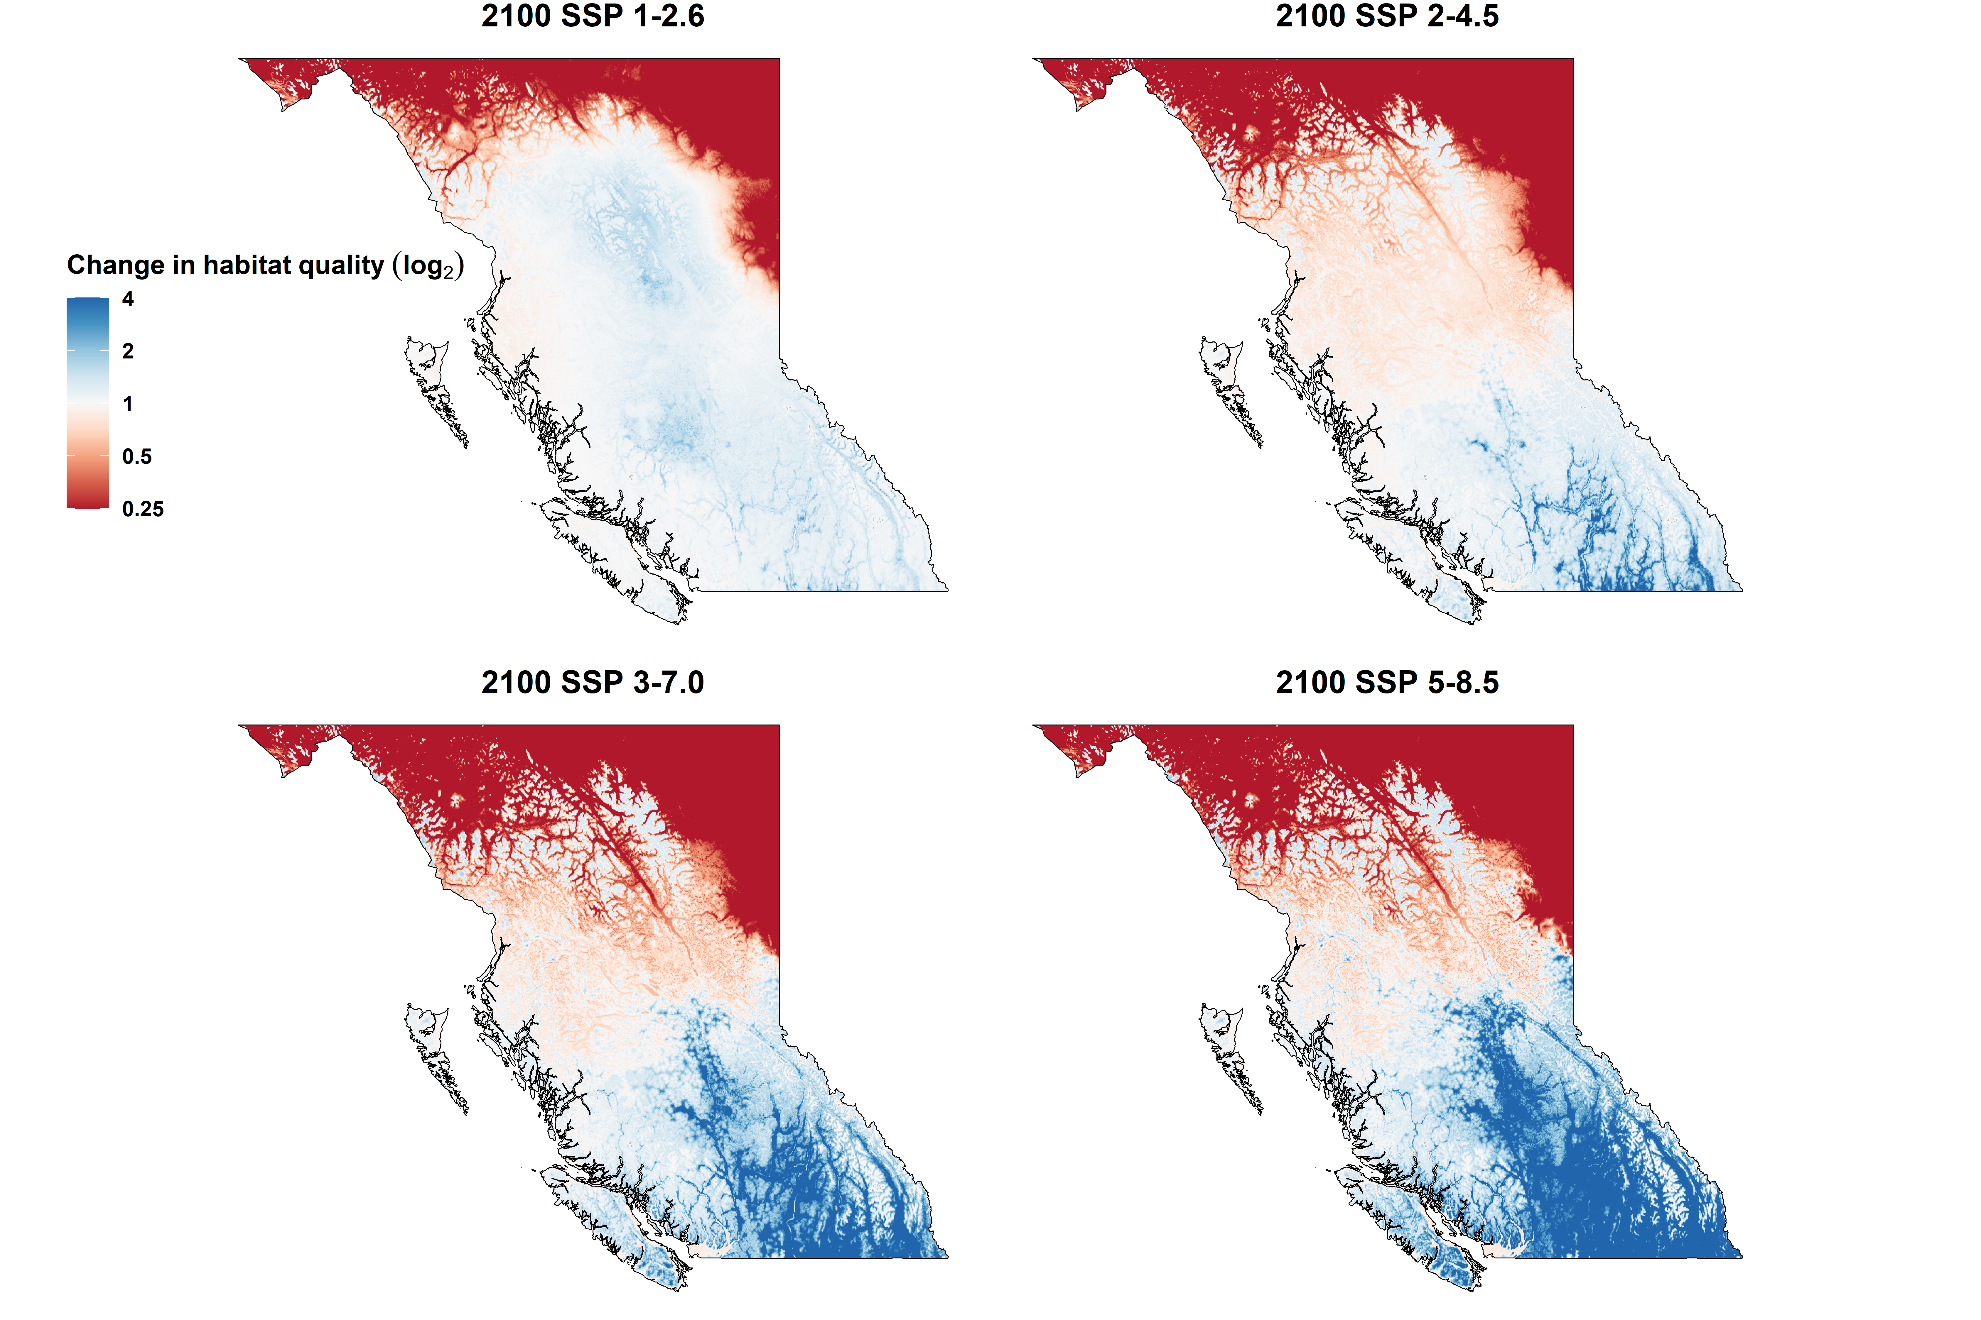
Best scenario
Good scenario
Bad scenario
Worst scenario

Slide 46







Acknowledgements

Slide 47
References
Bista, D., G. S. Baxter, N. J. Hudson, S. T. Lama, and P. J. Murray. 2022. Effect of disturbances and habitat fragmentation on an arboreal habitat specialist mammal using GPS telemetry: A case of the red panda. Landscape Ecology 37:795–809.
Geremia, C., J. A. Merkle, D. R. Eacker, R. L. Wallen, P. J. White, M. Hebblewhite, and M. J. Kauffman. 2019. Migrating bison engineer the green wave. Proceedings of the National Academy of Sciences 116:25707–25713.
Giroux A., Ortega Z., Attias N., Desbiez A. L. J., Valle D., Börger L., et al. (2023). Activity modulation and selection for forests help giant anteaters to cope with temperature changes. Animal Behaviour 201:191–209.
Herfindal, I., J. D. C. Linnell, J. Odden, E. B. Nilsen, and R. Andersen. 2005. Prey density, environmental productivity and home-range size in the Eurasian lynx (Lynx lynx). Journal of Zoology 265:63–71.
Lucherini, M., and S. Lovari. 1996. Habitat richness affects home range size in the red fox Vulpes vulpes. Behavioural Processes 36:103–105.
Martinez-Garcia R., Fleming C. H., Seppelt R., Fagan W. F. & Calabrese J. M. (2020). How range residency and long-range perception change encounter rates. Journal of Theoretical Biology 498, 110267.
Nilsen, E. B., I. Herfindal, and J. D. C. Linnell. 2005. Can intra-specific variation in carnivore home-range size be explained using remote-sensing estimates of environmental productivity? Écoscience 12:68–75.
Relyea, R. A., R. K. Lawrence, and S. Demarais. 2000. Home Range of Desert Mule Deer: Testing the Body-Size and Habitat-Productivity Hypotheses. The Journal of Wildlife Management 64:146.
Rickbeil, G. J. M., J. A. Merkle, G. Anderson, M. P. Atwood, J. P. Beckmann, E. K. Cole, A. B. Courtemanch, et al. 2019. Plasticity in elk migration timing is a response to changing environmental conditions. Global Change Biology 25:2368–2381.
Rizzuto M., Leroux S.J., Vander Wal E., Richmond I.C., Heckford T.R., Balluffi-Fry J., et al. (2021). Forage stoichiometry predicts the home range size of a small terrestrial herbivore. Oecologia 197, 327–338.
Williams-Guillen, K., C. McCann, J. C. Martinez Sanchez, and F. Koontz. 2006. Resource availability and habitat use by mantled howling monkeys in a Nicaraguan coffee plantation: Can agroforests serve as core habitat for a forest mammal? Animal Conservation 9:331–338.

Slide 48
References and credits
Aerial photo of Okanagan Lake: © University of British Columbia Okanagan
Picture of frozen Okanagan Lake: © Kelowna Public Archives: KPA #487
Cougar phylopic: CC BY-NC 3.0: Cristian Osorio & Paula Carrera, Proyecto Carnivoros Australes
Mountain goat phylopic: CC-BY-SA 3.0: Sarah E. Haworth
R code can be found at https://github.com/QuantitativeEcologyLab/bc-mammals-speeds/

